Slide 1
The Great Tote Extravaganza!
Or…
How MCLS staff spent June 2013

Slide 2
Introducing RIDES totes!
In the fall of 2012 the RIDES Task Force was formed to investigate how to improve statewide delivery service. It was recommended that pricing be based on the volume of material sent by each library, and the best way to measure that volume is to track the number of totes delivered and picked up.
To do that fairly, we had to have standard size totes. So MCLS decided to purchase all of the totes to be used by RIDES.
We reviewed prior volume surveys to estimate that we needed 8,000 totes in two sizes for distribution statewide.
Months of planning and preparation came together in June 2013.

Slide 3
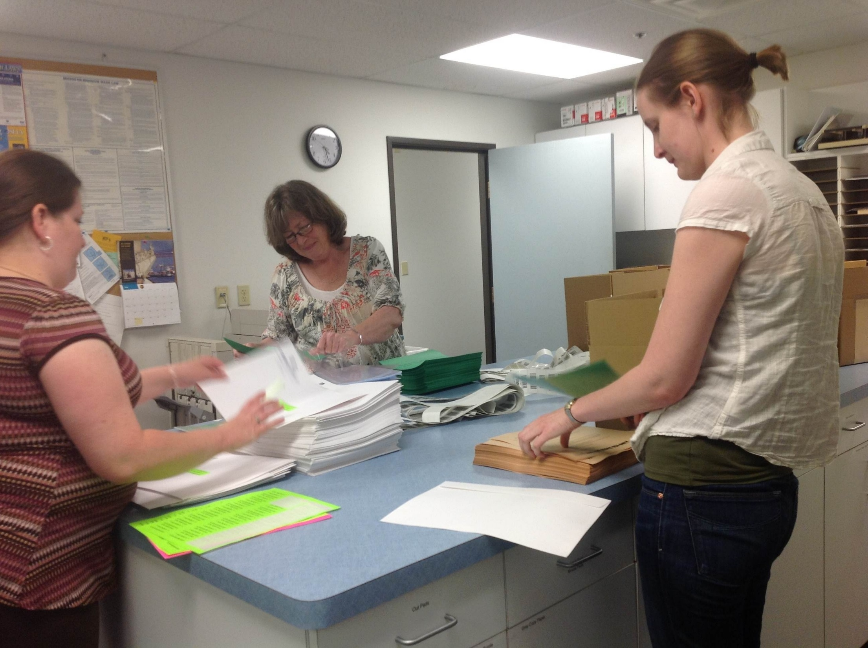
We created and sent each direct delivery site barcodes specific to their site.

Slide 4
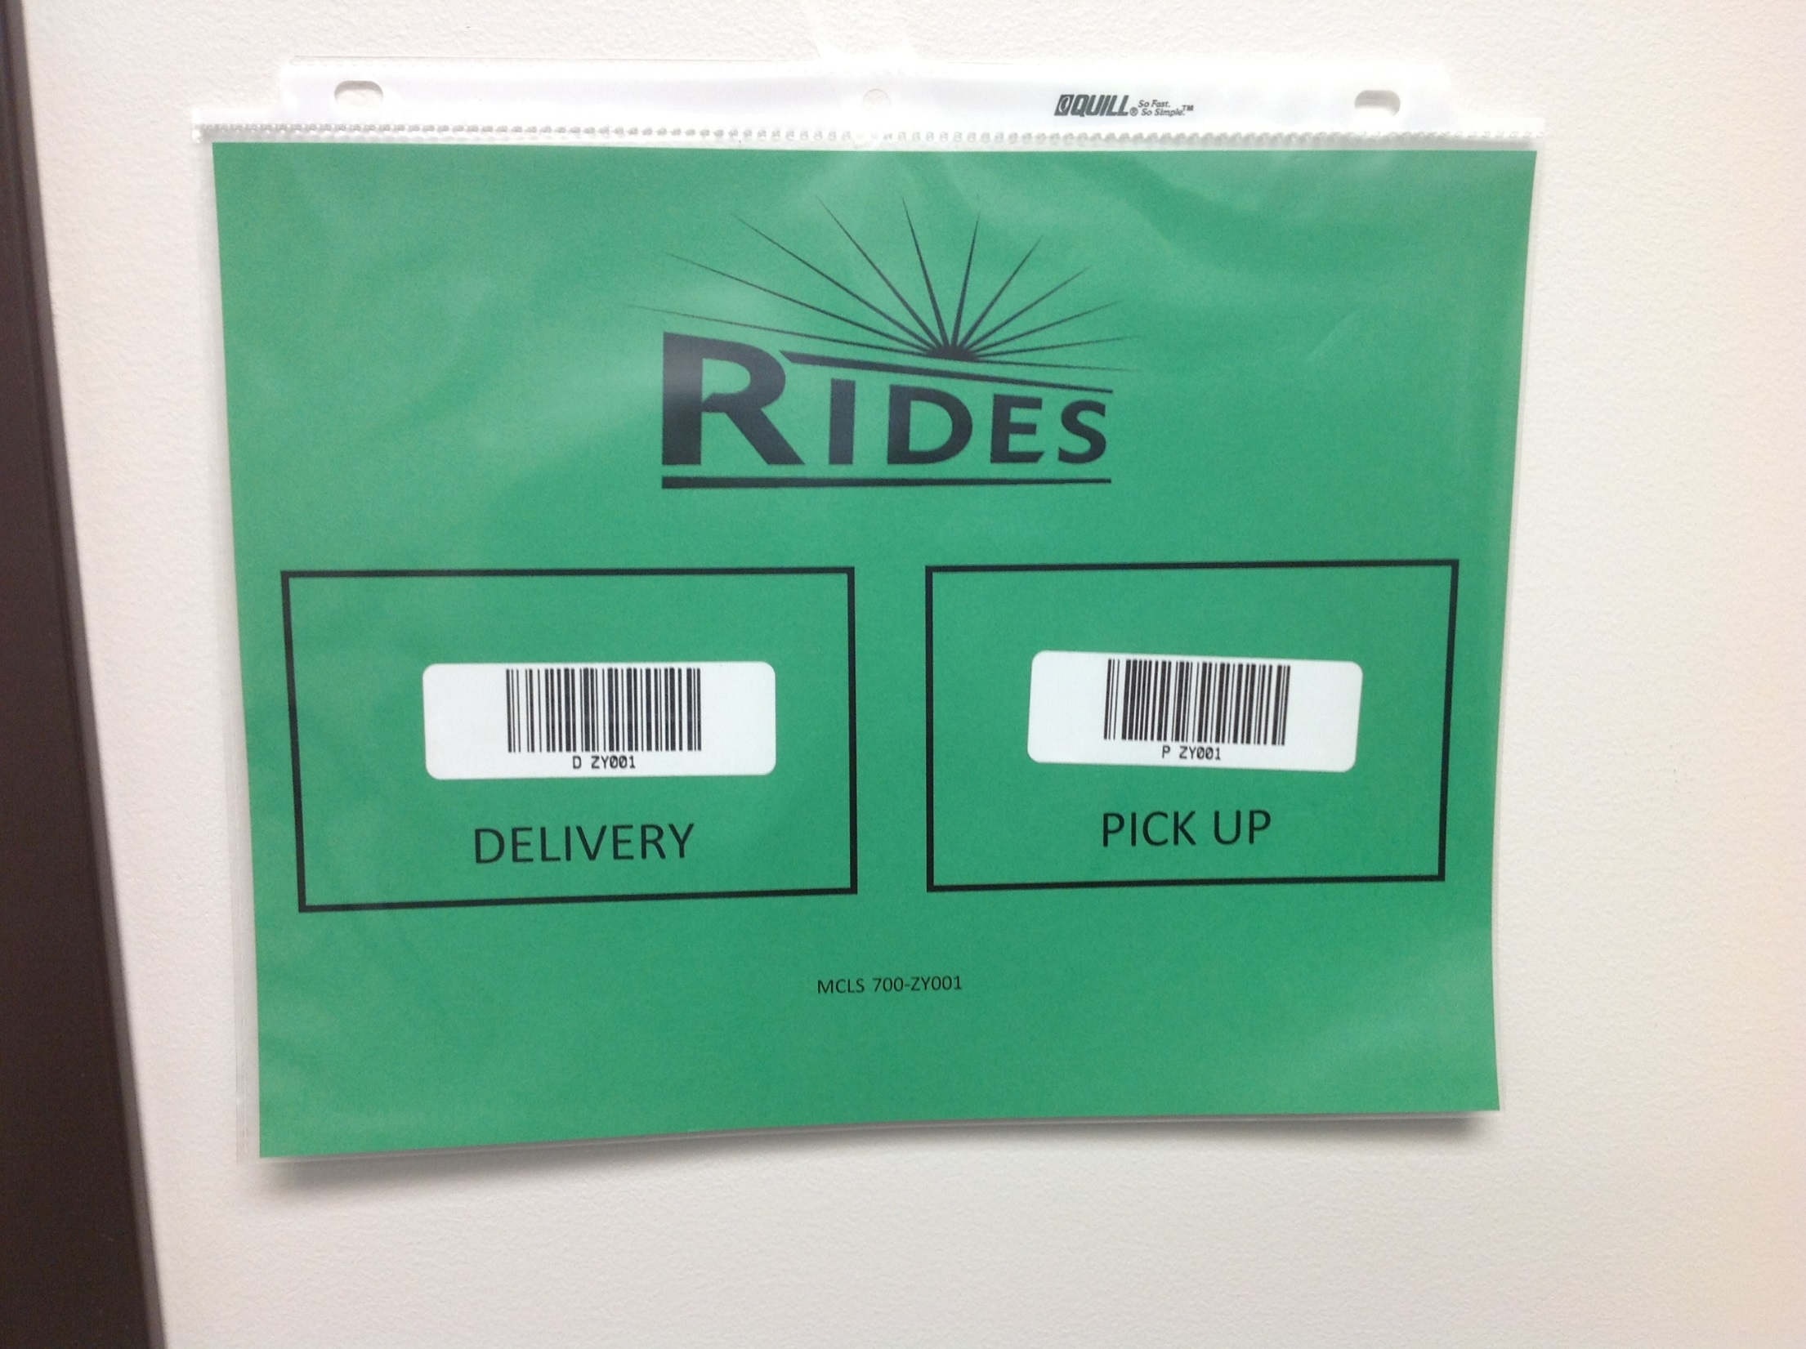
The barcodes are to be scanned by the courier every time service is provided, followed by scanning the tote barcodes for both pick up and delivery.

Slide 5
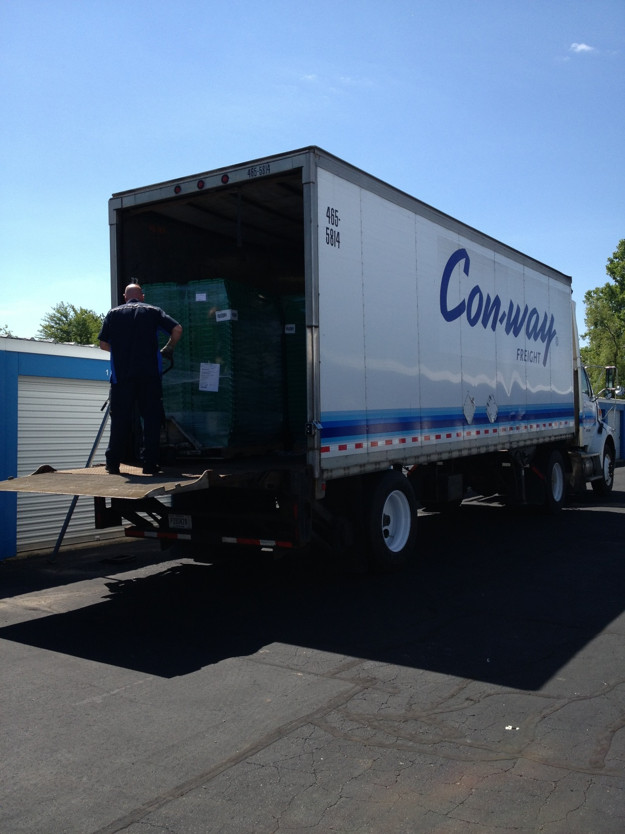
We staged the tote processing at the National Storage facility on Jolly Rd. in Okemos.
In phases over a three week period we received six (6!) semi-truck loads.

Slide 6
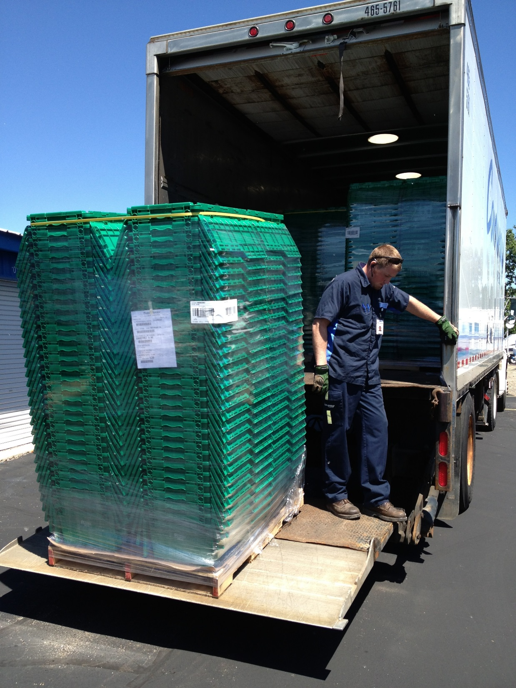
In all there were 67 pallets, each with over 100 empty totes, that were unloaded and moved into storage units.

Slide 7
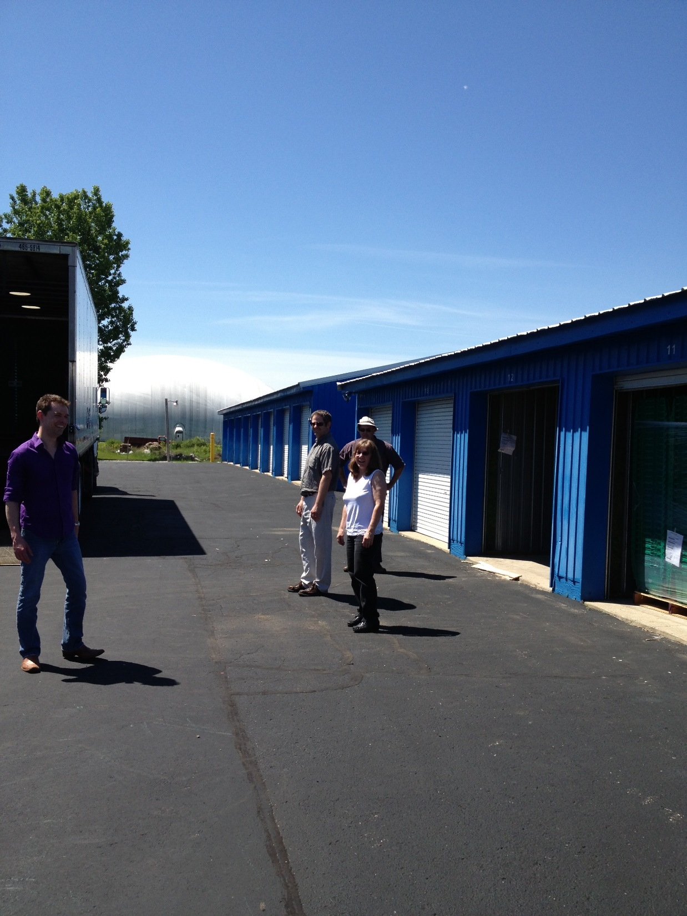
MCLS staff helped with unloading trucks and moving pallets.

Slide 8
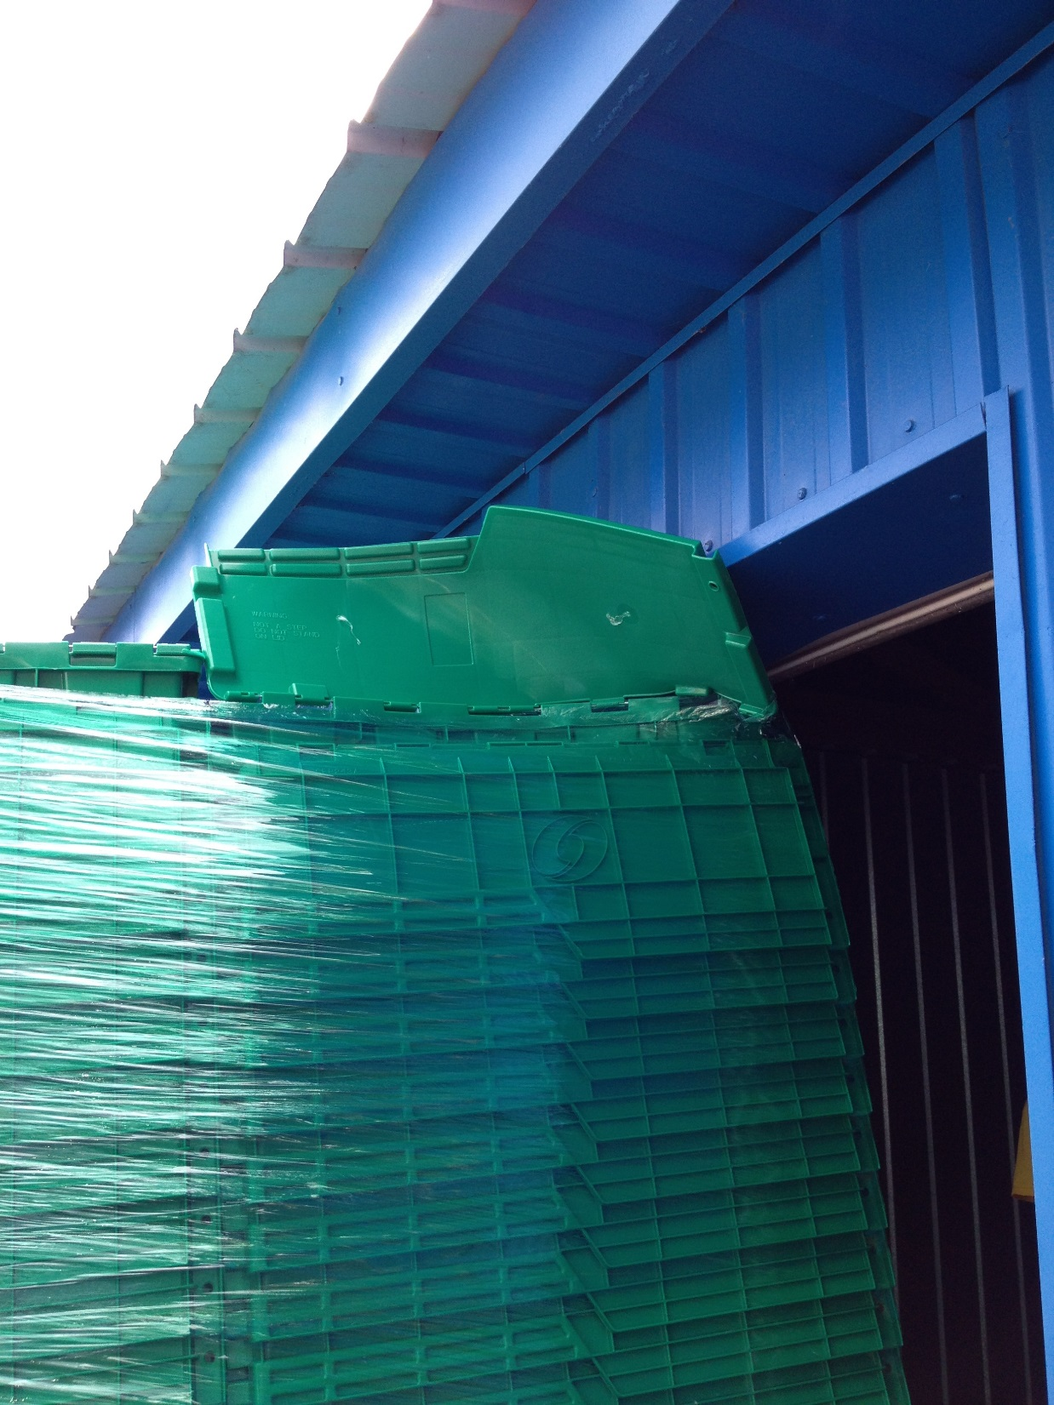
Staff occasionally was a little too enthusiastic…

Slide 9
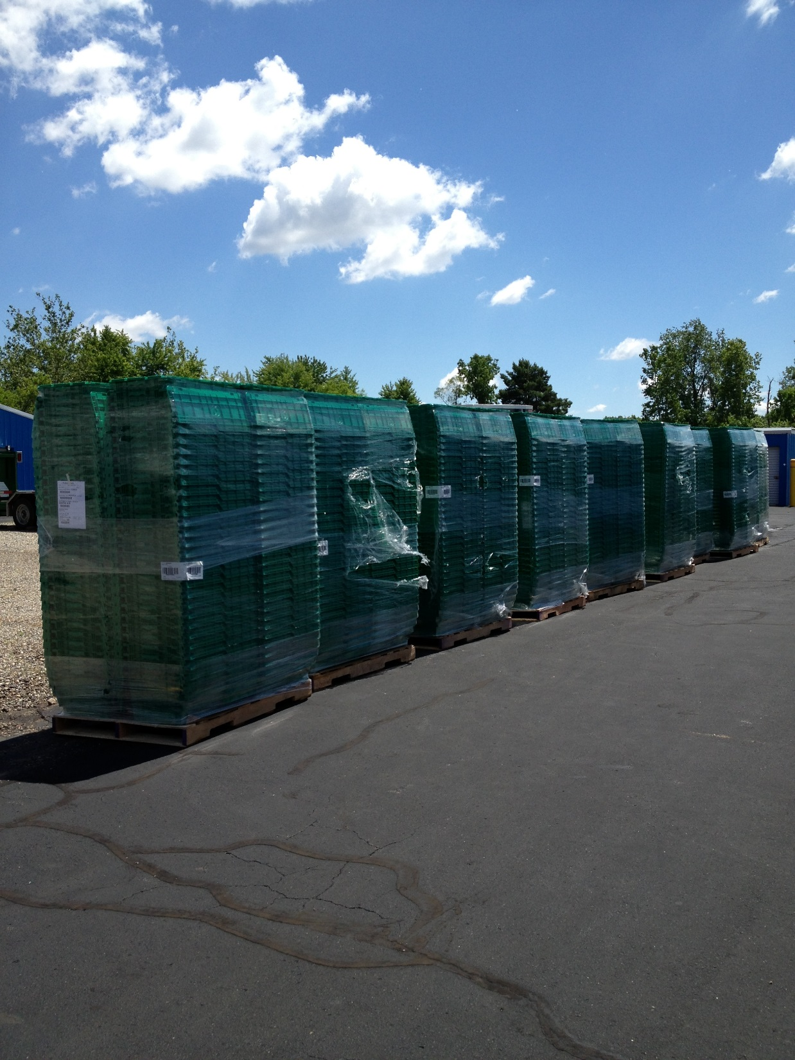
Just a few of the pallets waiting their turn.

Slide 10
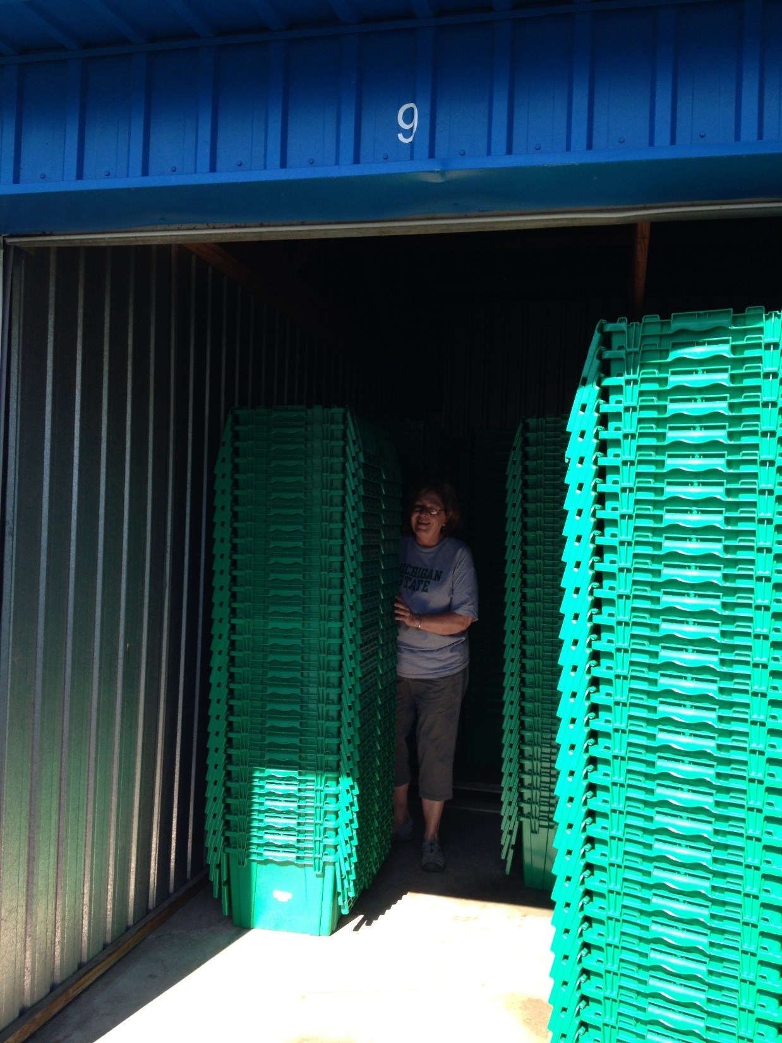
On ‘Barcoding Days’ the totes were unwrapped and moved out of the storage unit.

Slide 11
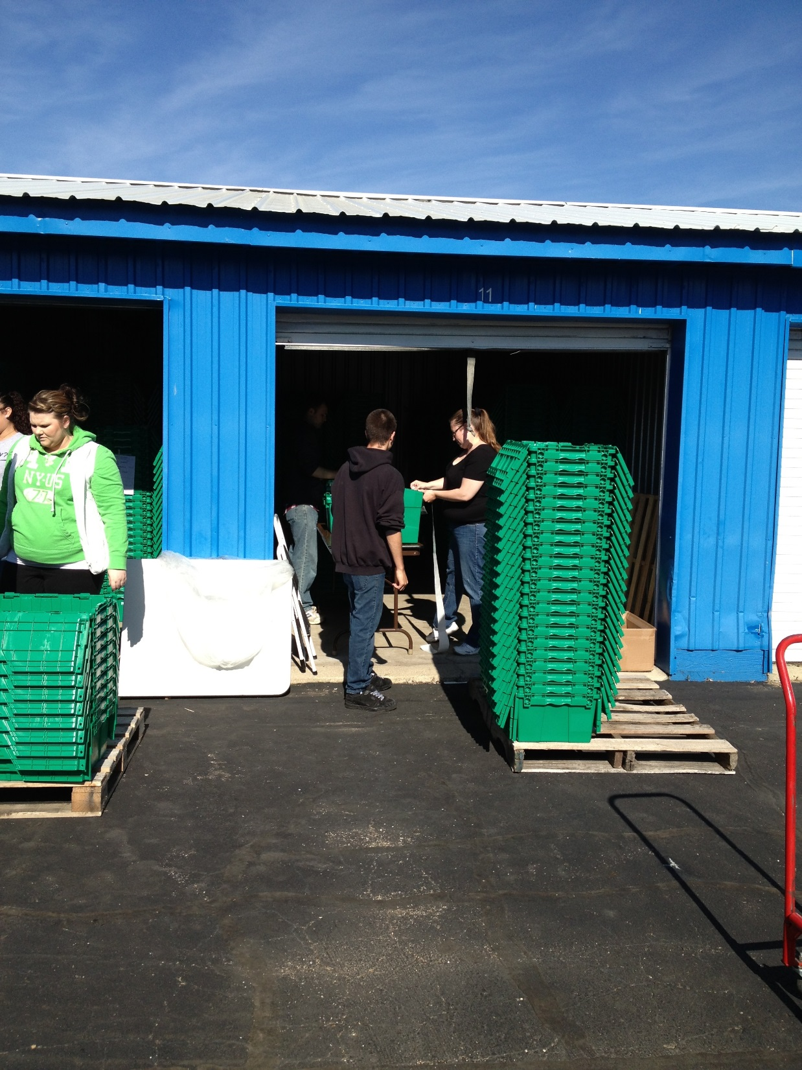
MCLS staff and five temp workers attached two matching barcodes to each tote.

Slide 12
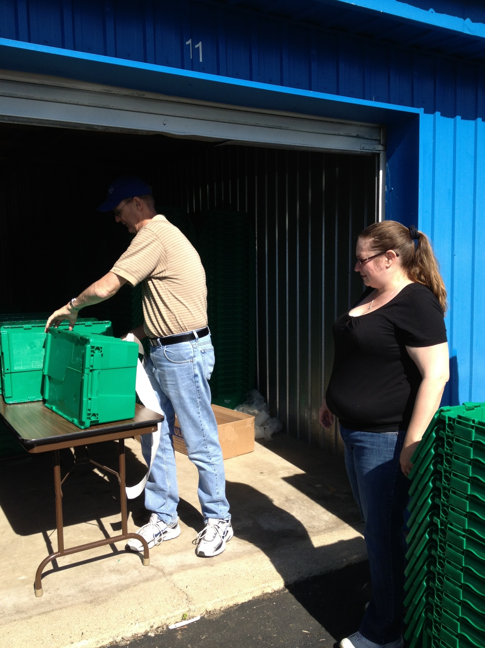
We developed an assembly line.

Slide 13
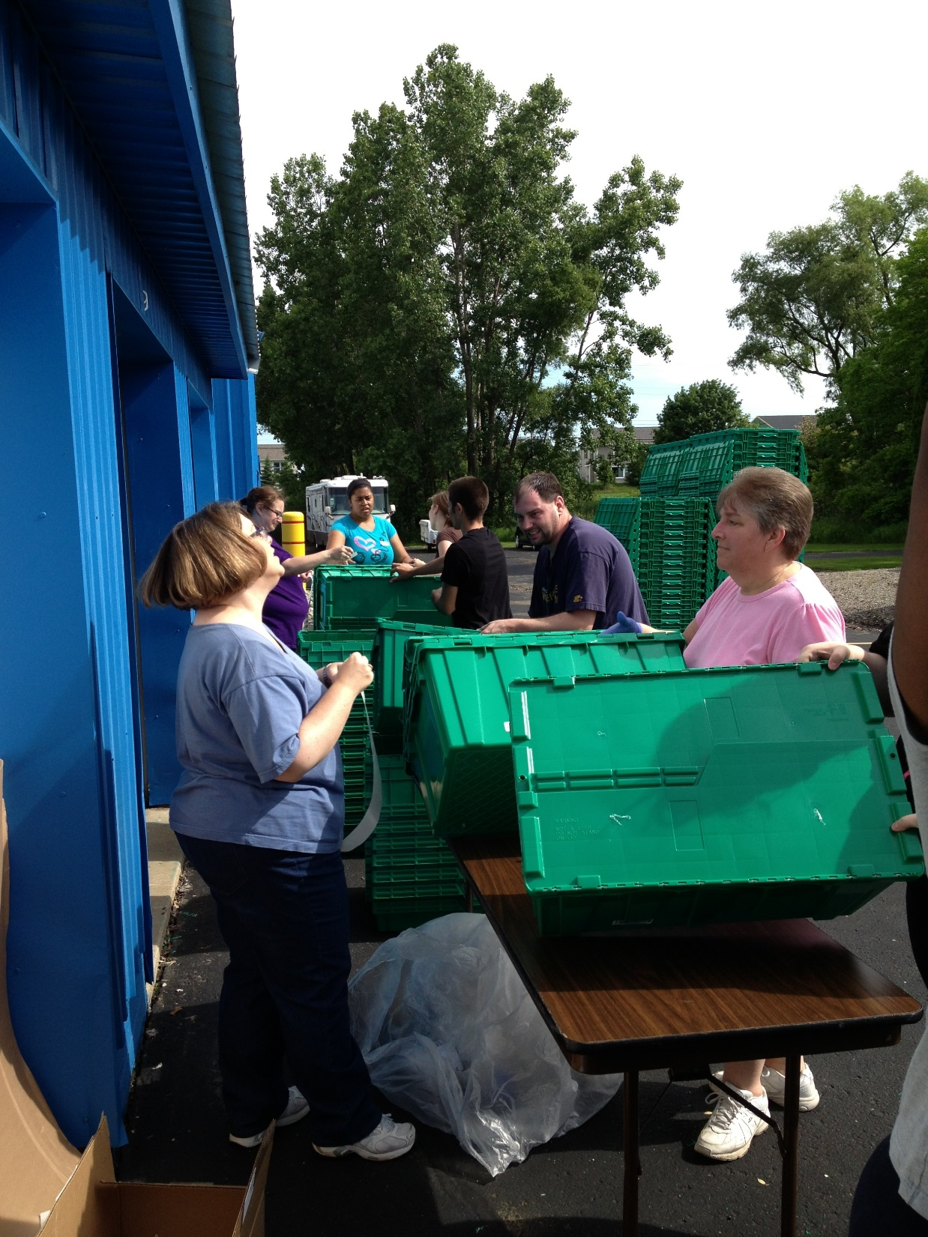
Each tote had to be pulled off the stack…

Slide 14
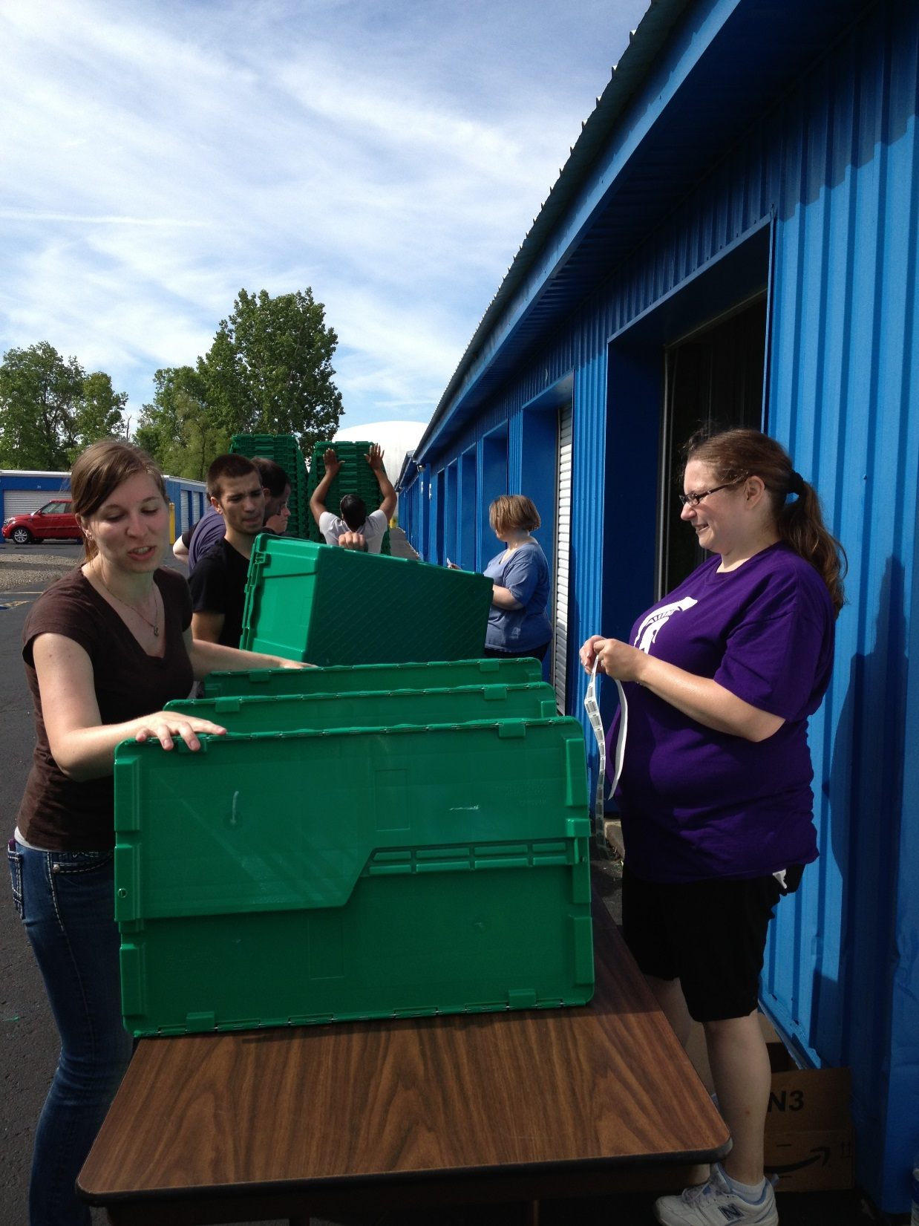
…barcoded in a particular spot…

Slide 15
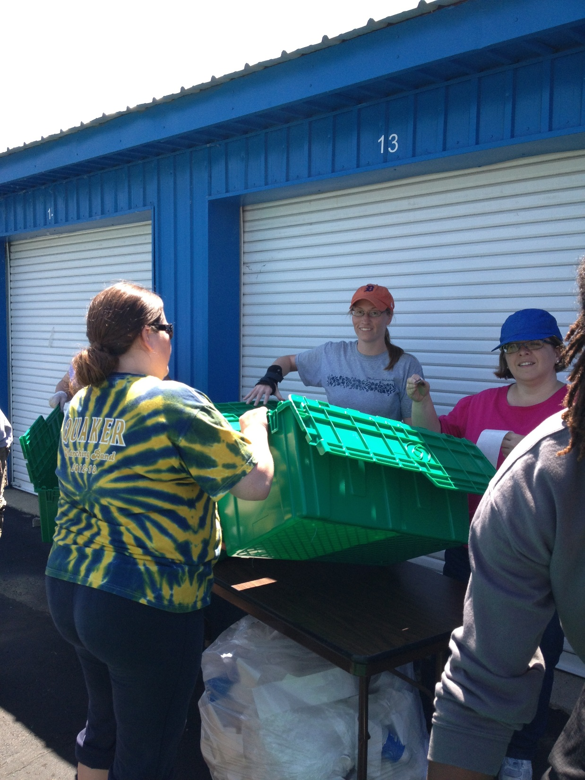
…flipped over…

Slide 16
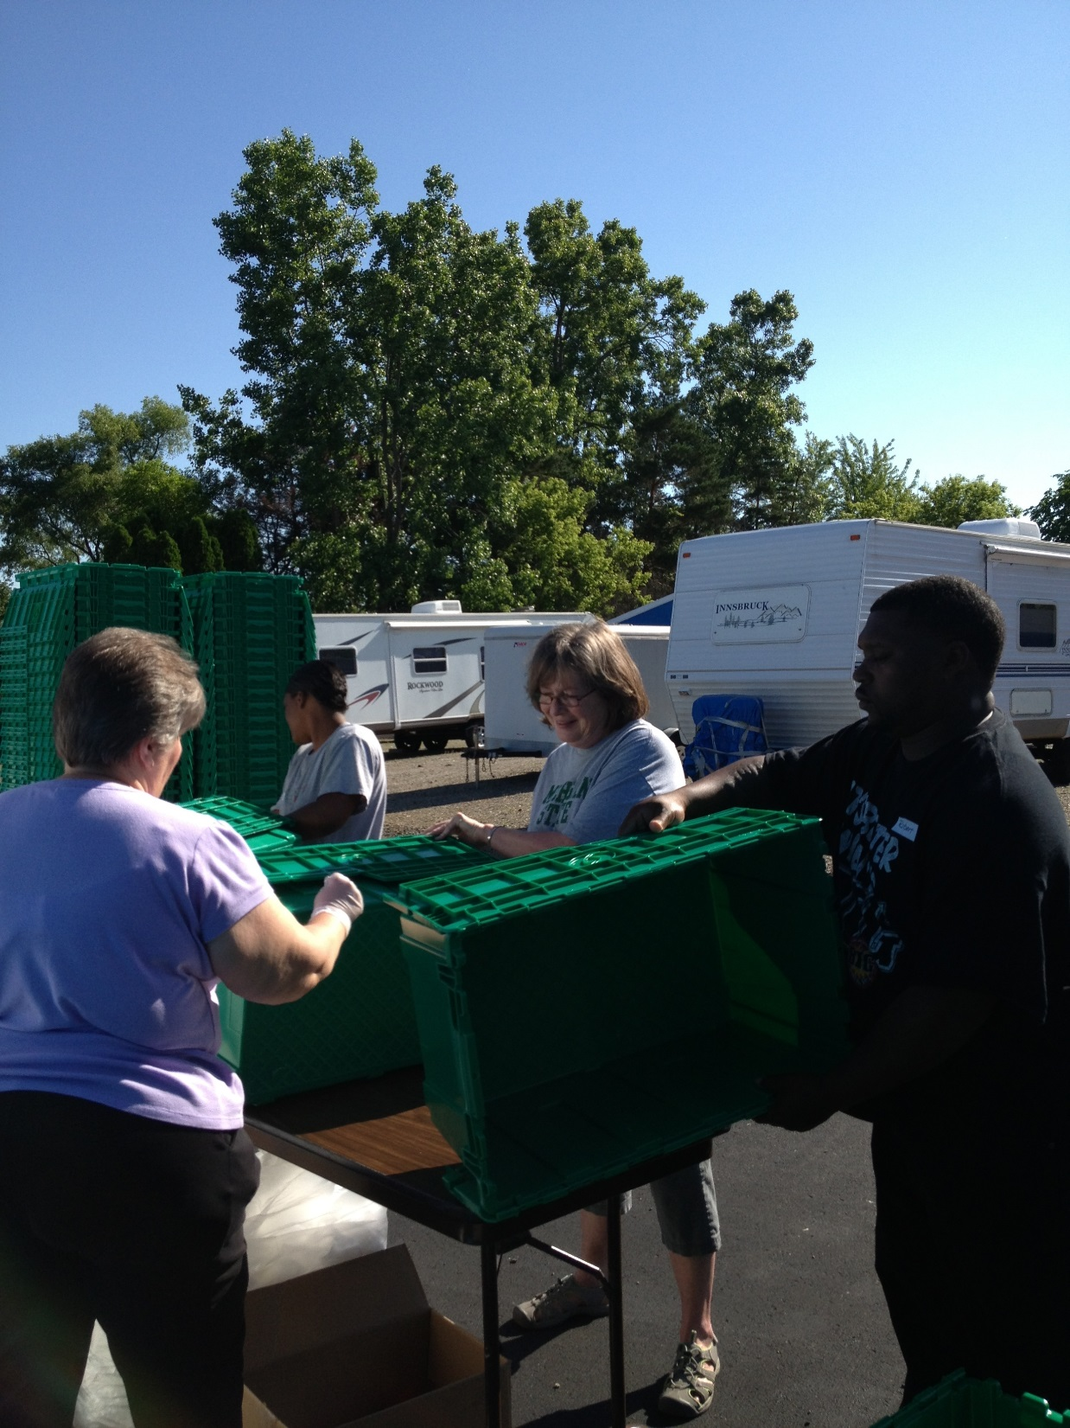
…a matching barcode attached on the other side…

Slide 17
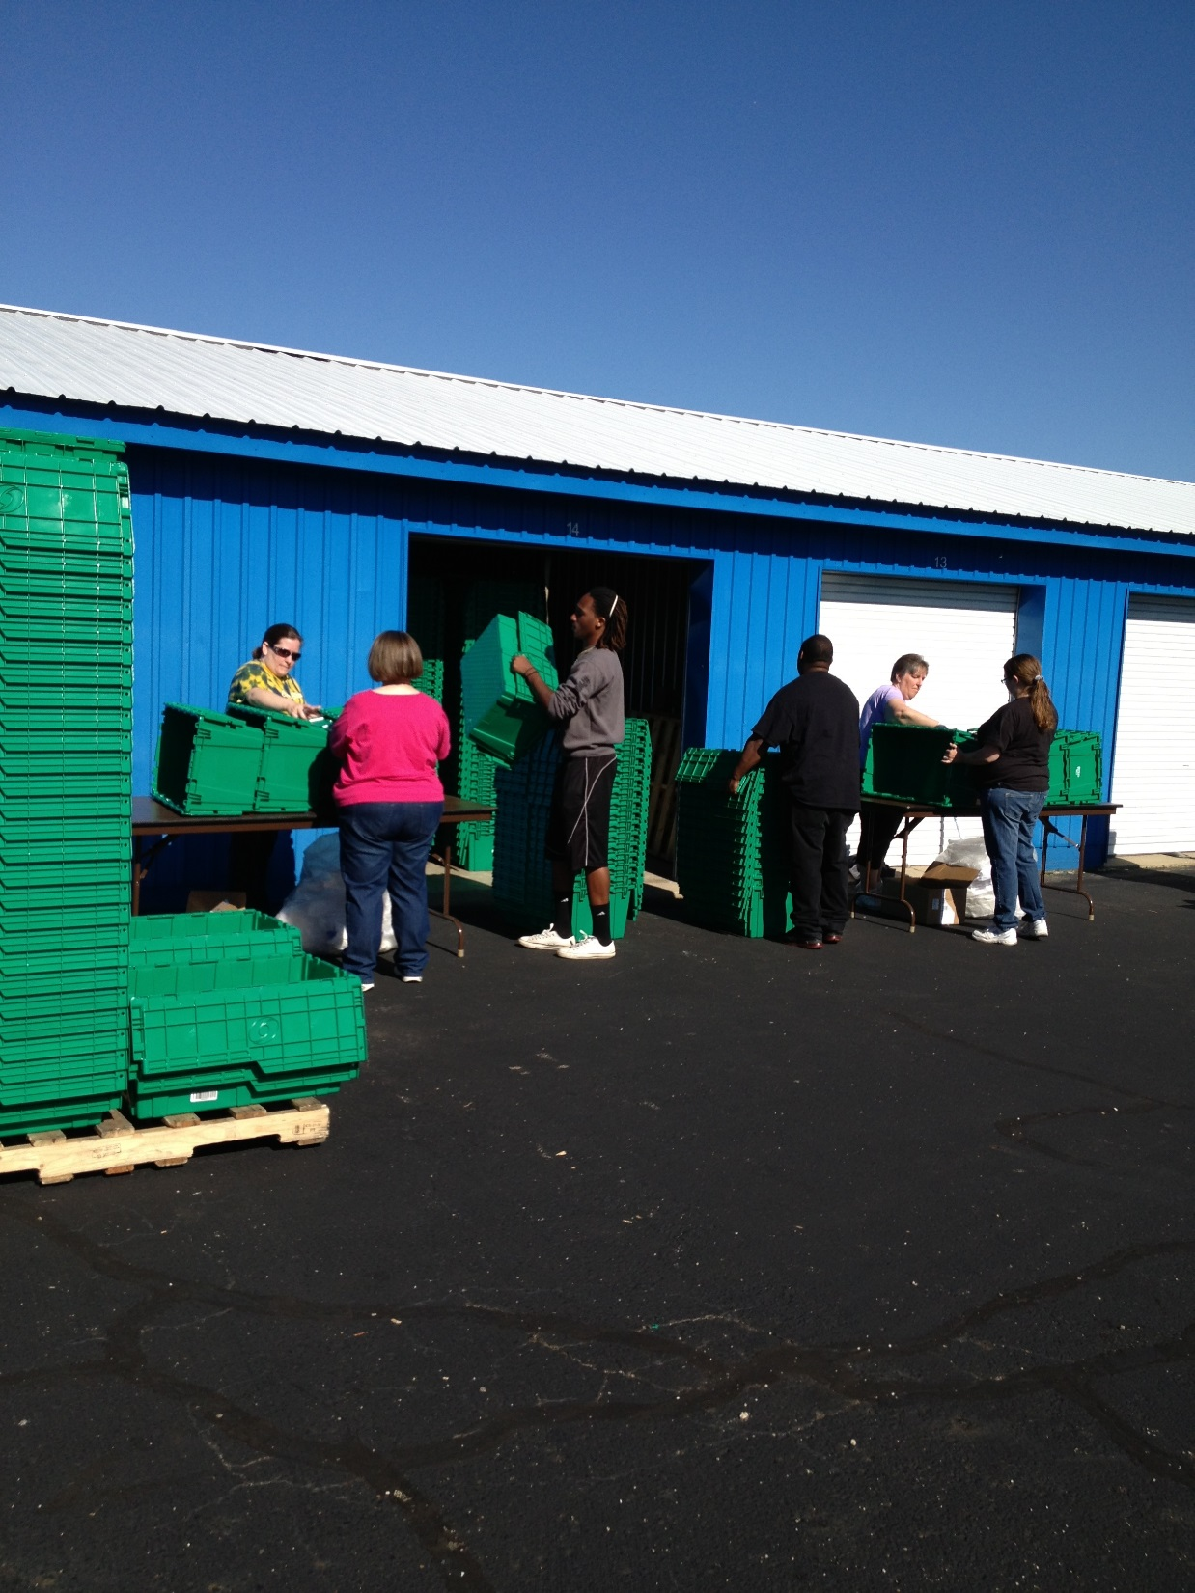
…and stacked back on a pallet.

Slide 18
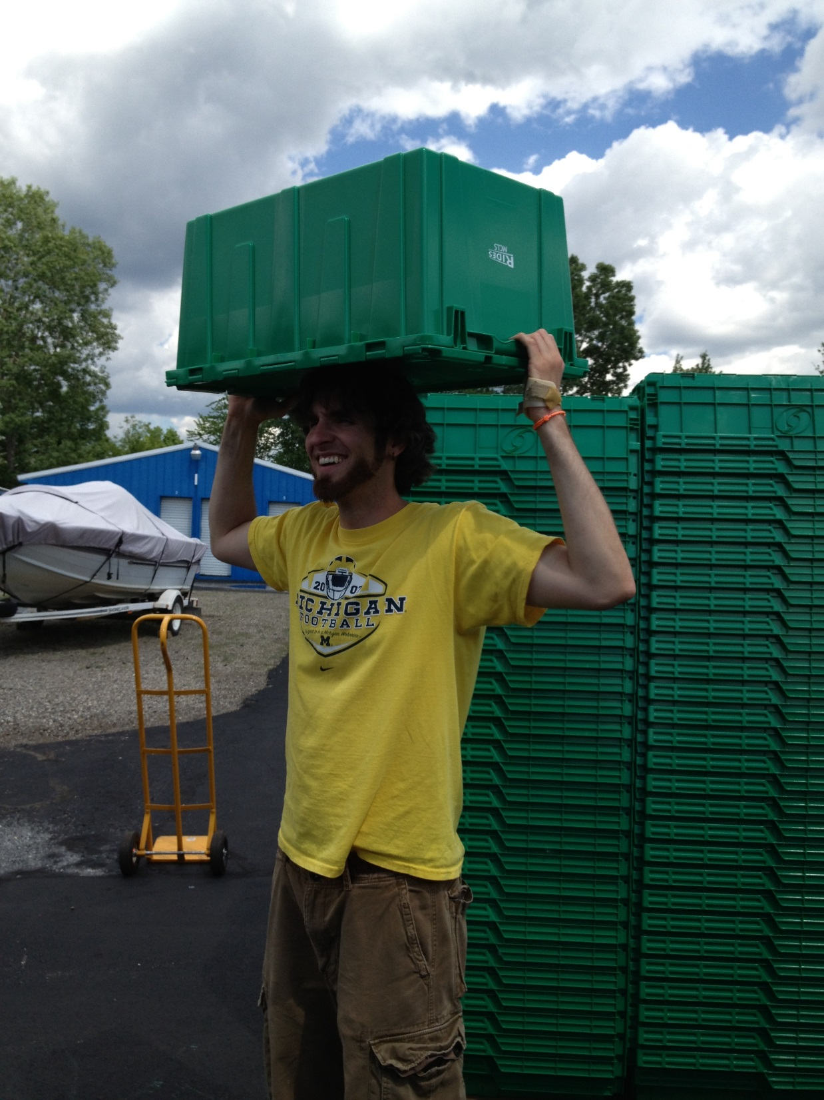
It was tough always being the tallest person there.

Slide 19
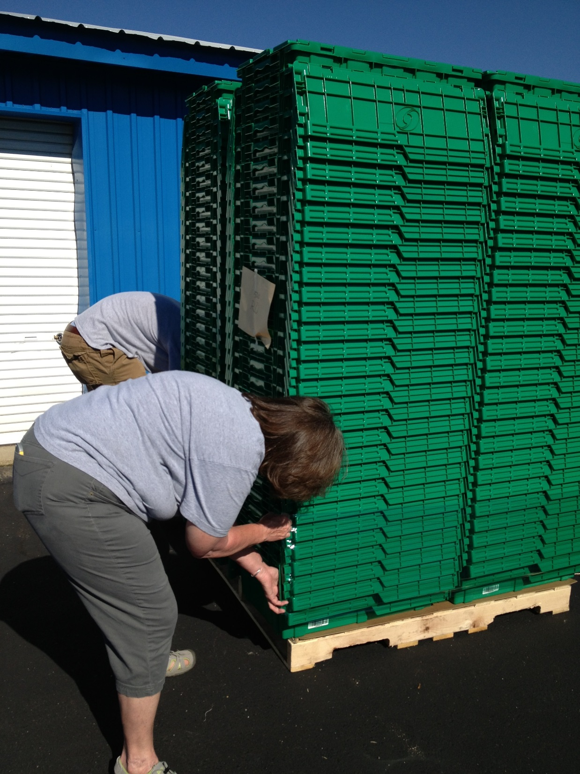
Each pallet then had to be labeled for delivery to the warehouse and secured with stretch wrap.

Slide 20
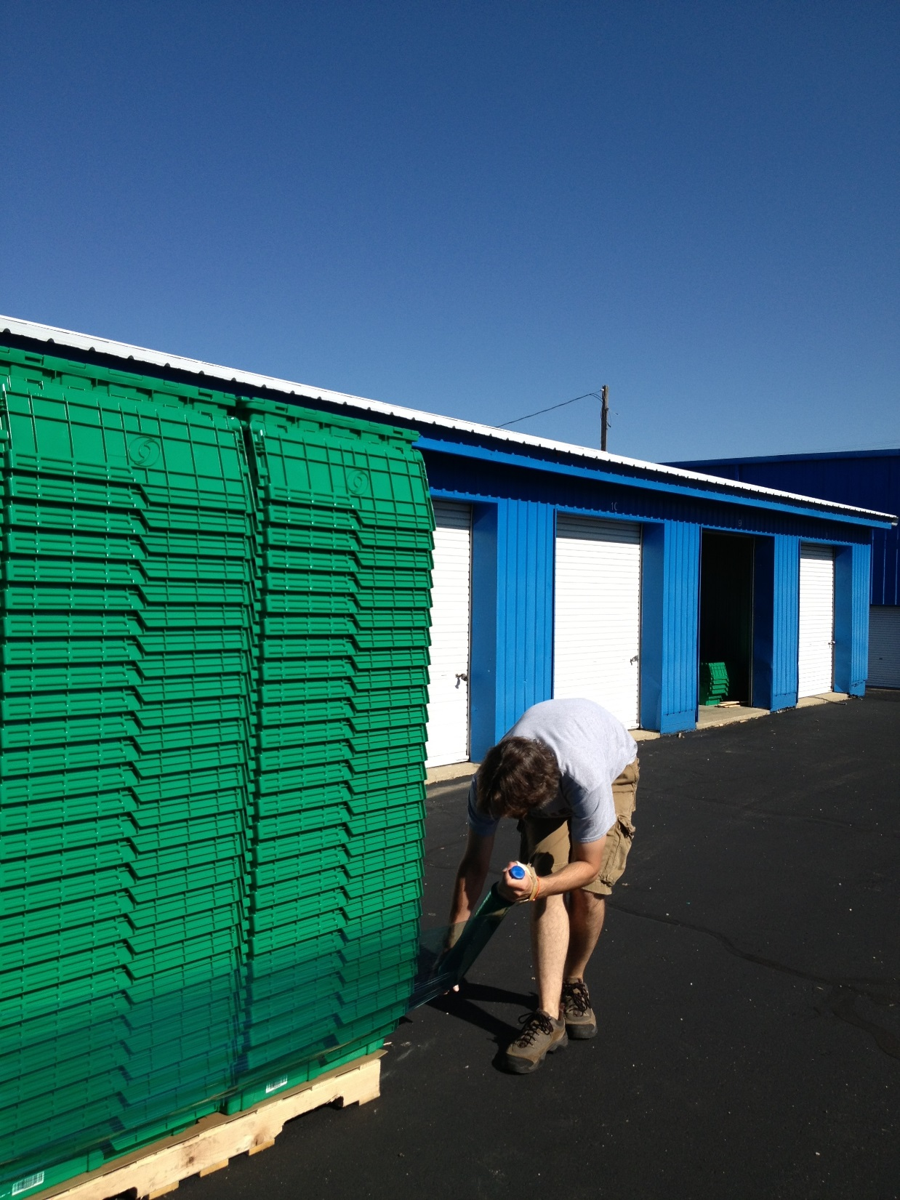
Which seems easy enough...

Slide 21
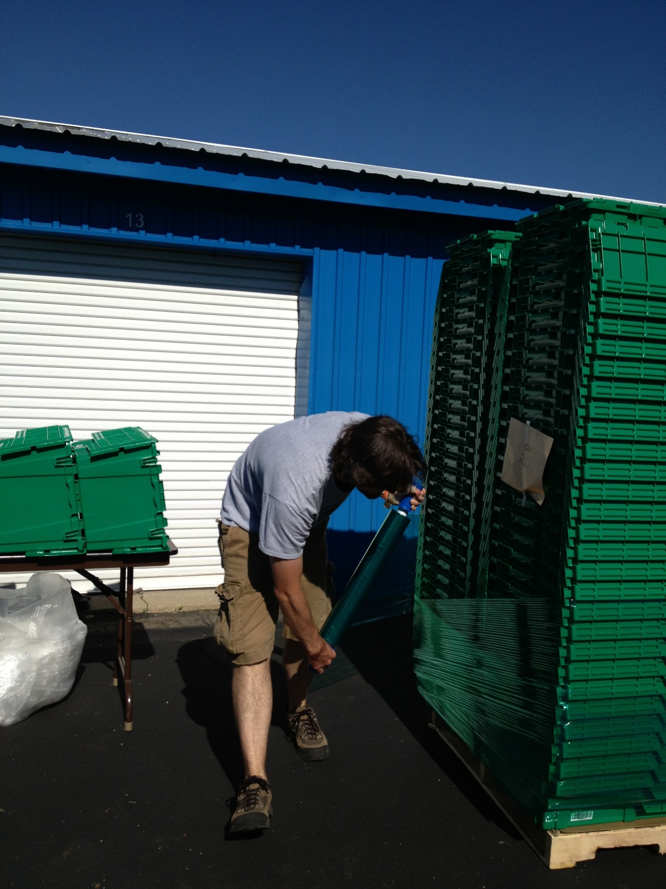
...

Slide 22
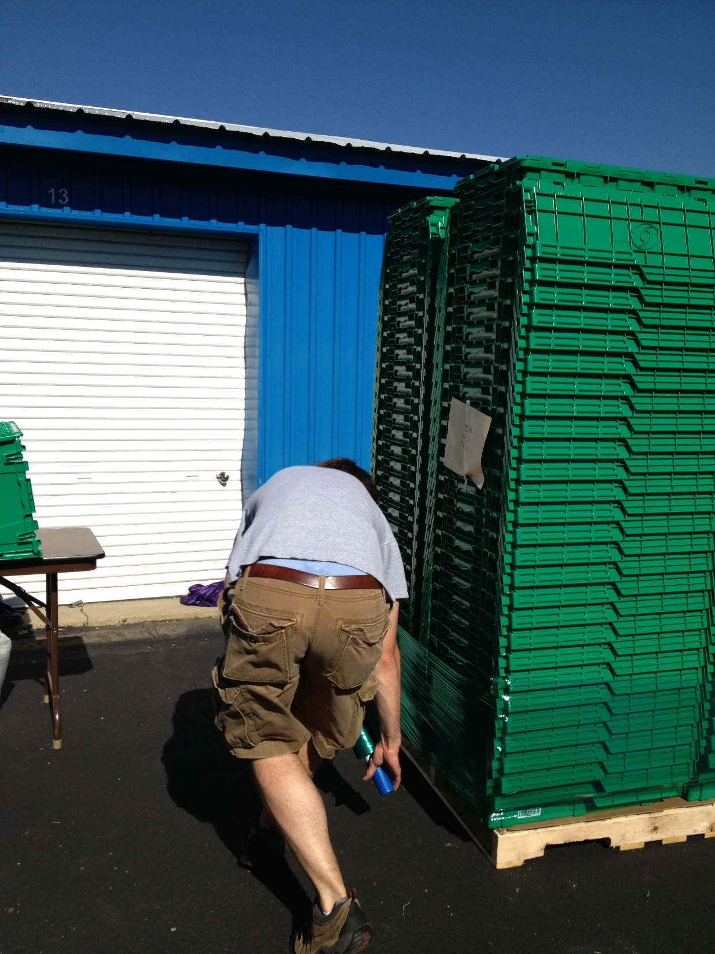
...

Slide 23
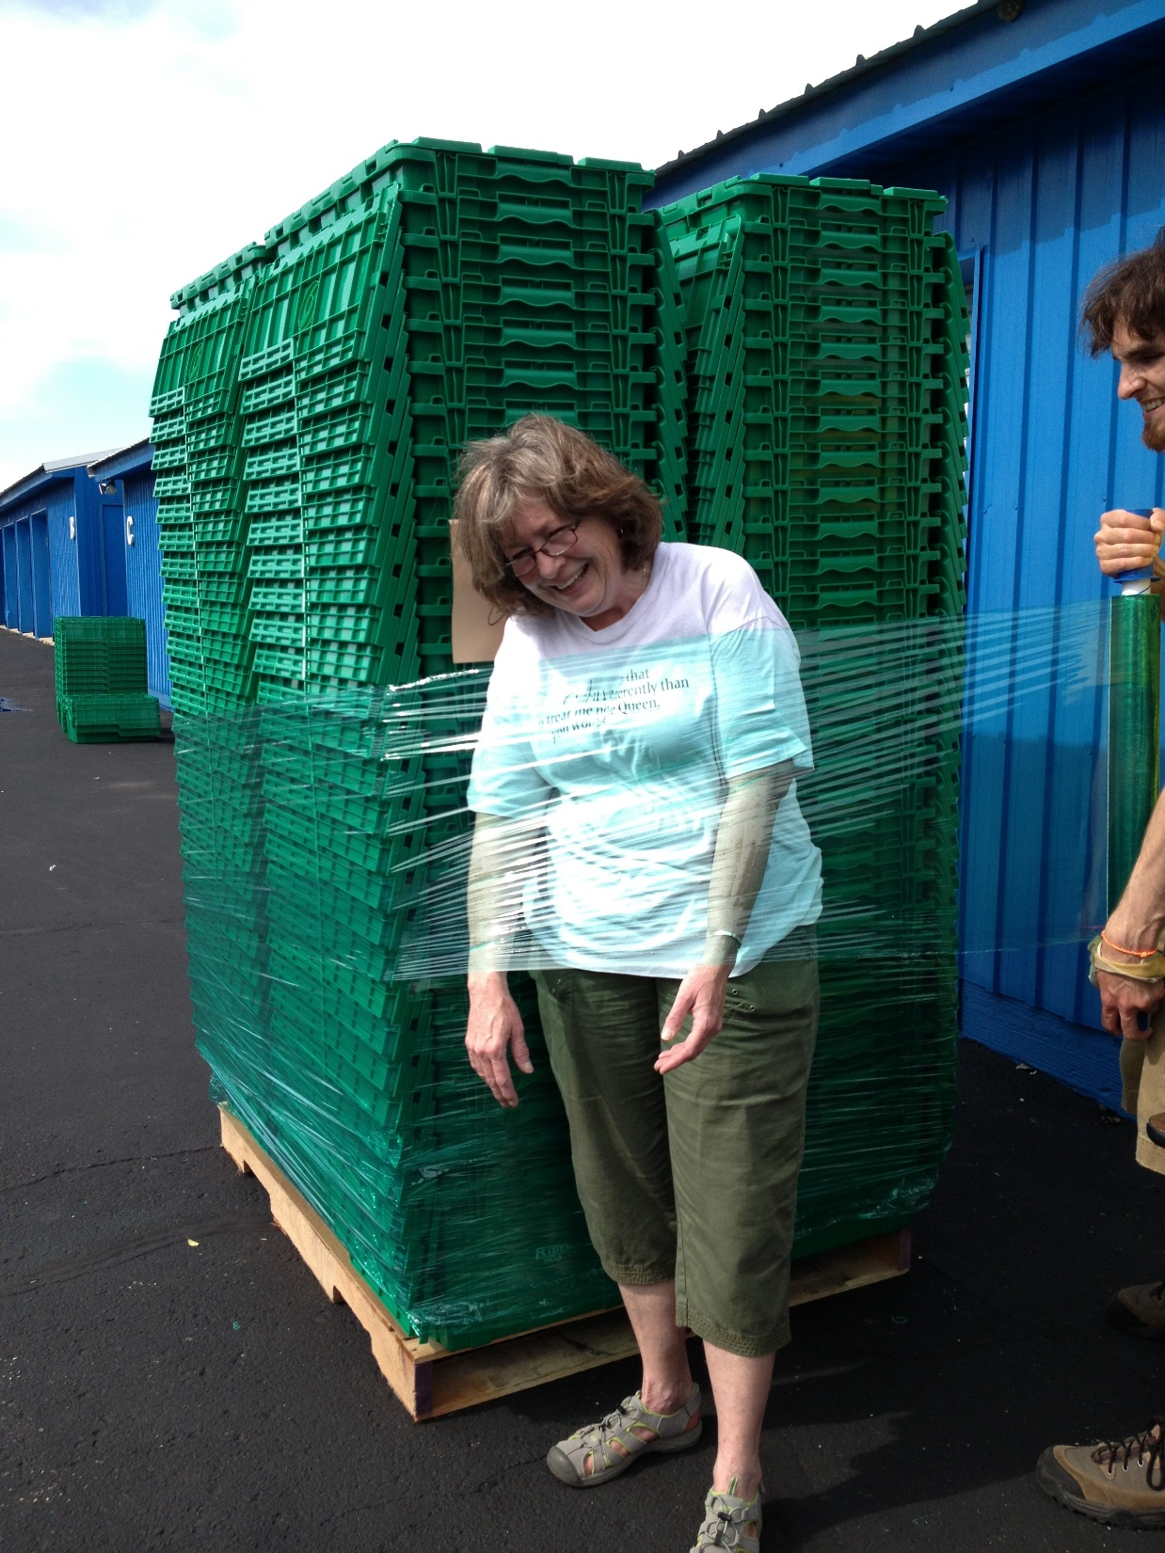
…as long as you stay out of the way!

Slide 24
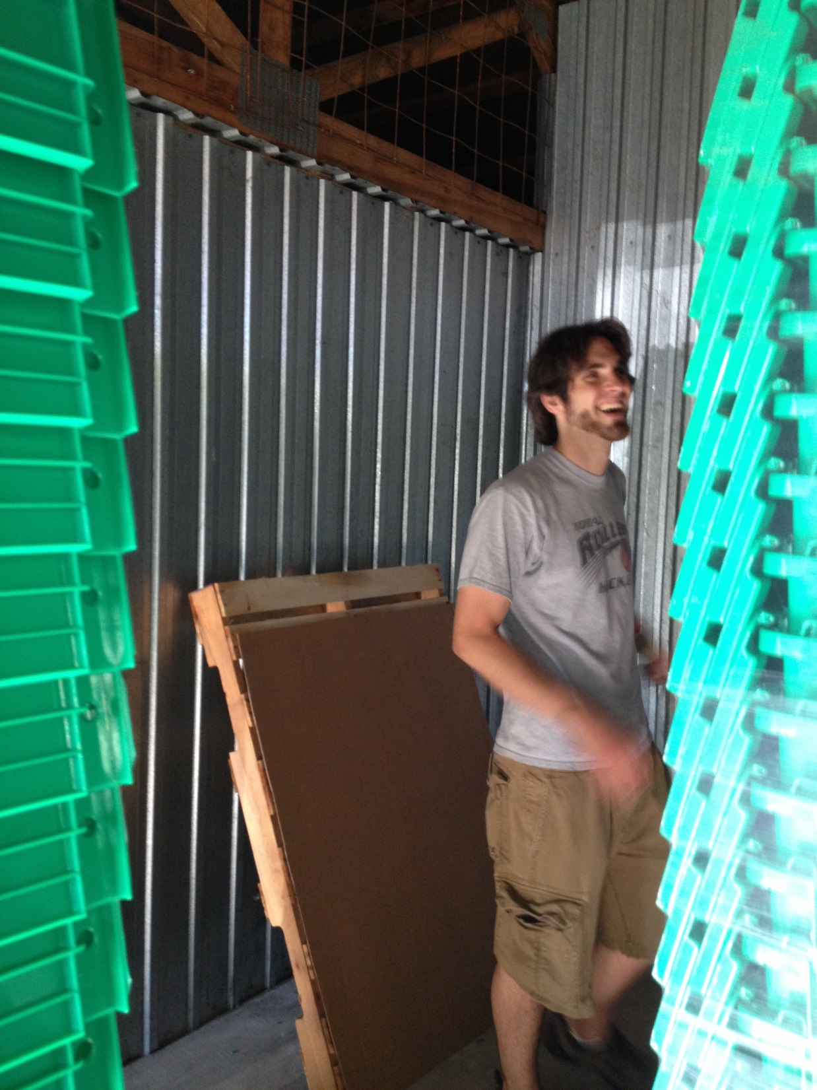
The pallets were then returned to the storage unit.

Slide 25
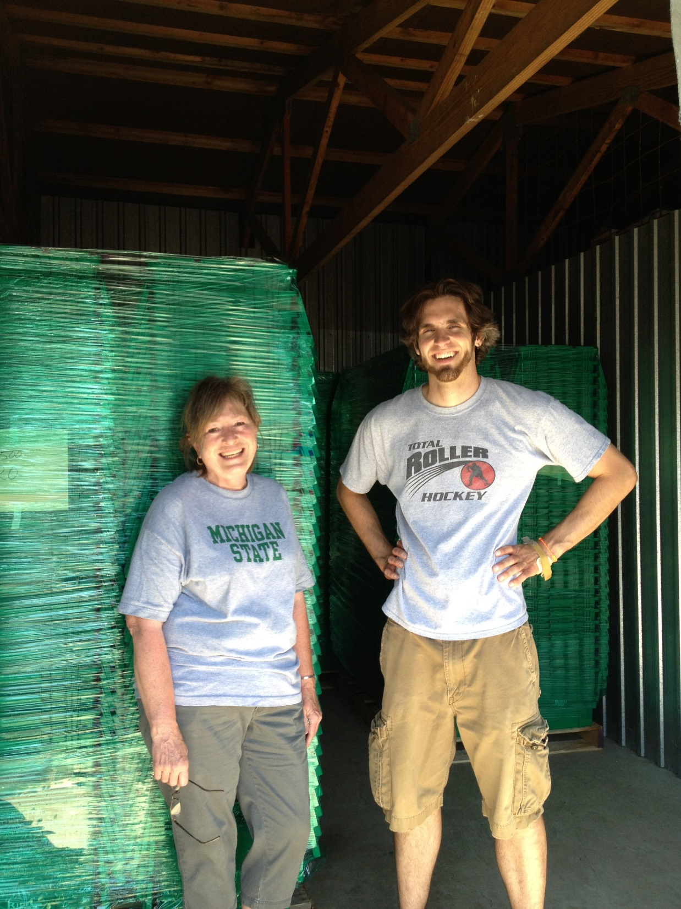
The Queen of Delivery and the Lord of the Pallets.

Slide 26
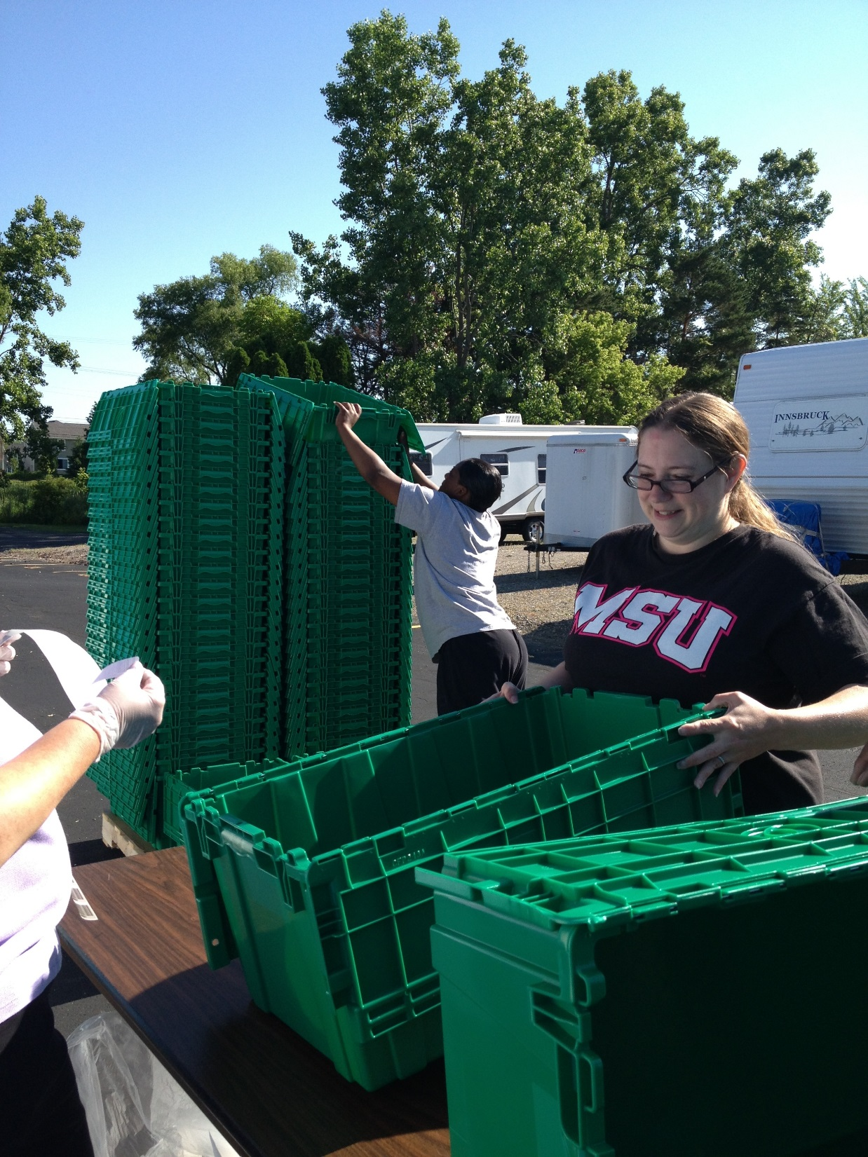
It took days to barcode all 8,000 totes.

Slide 27
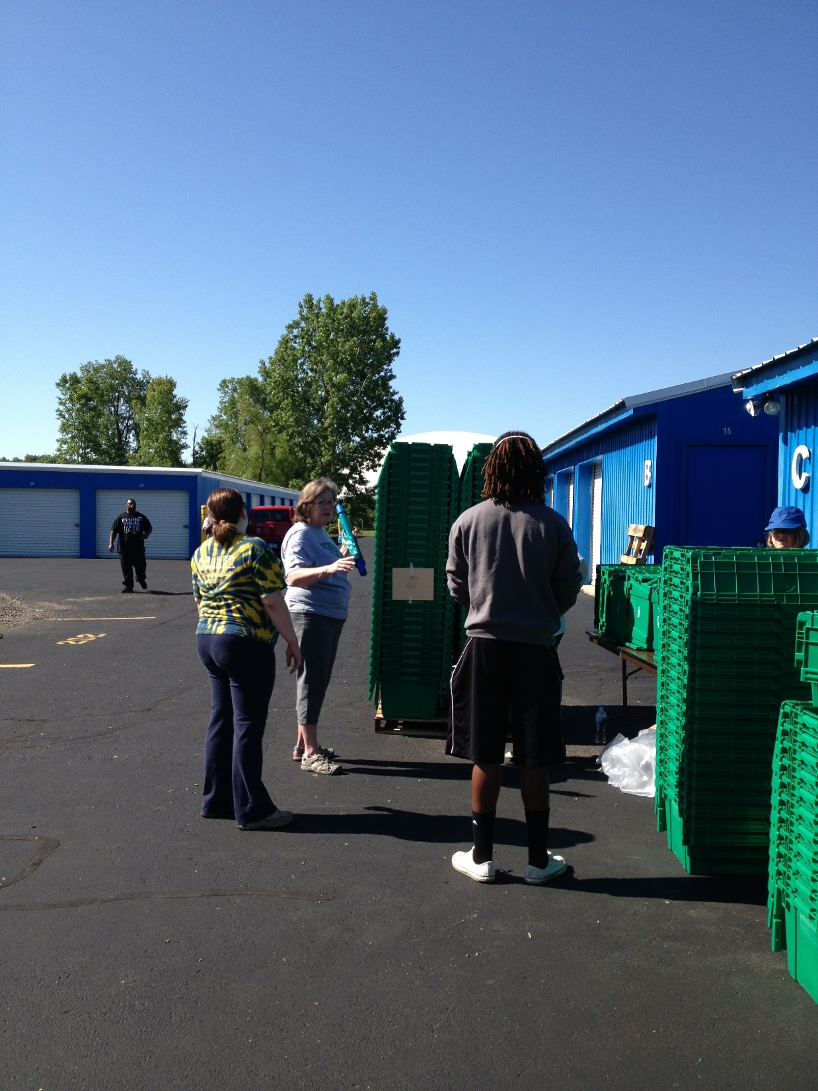
And days.

Slide 28
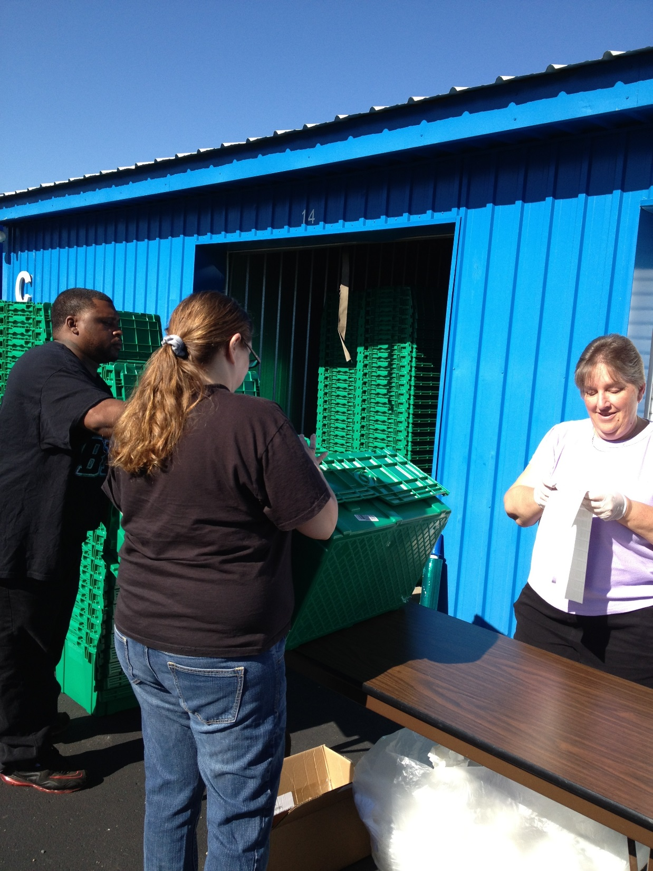
And days.

Slide 29
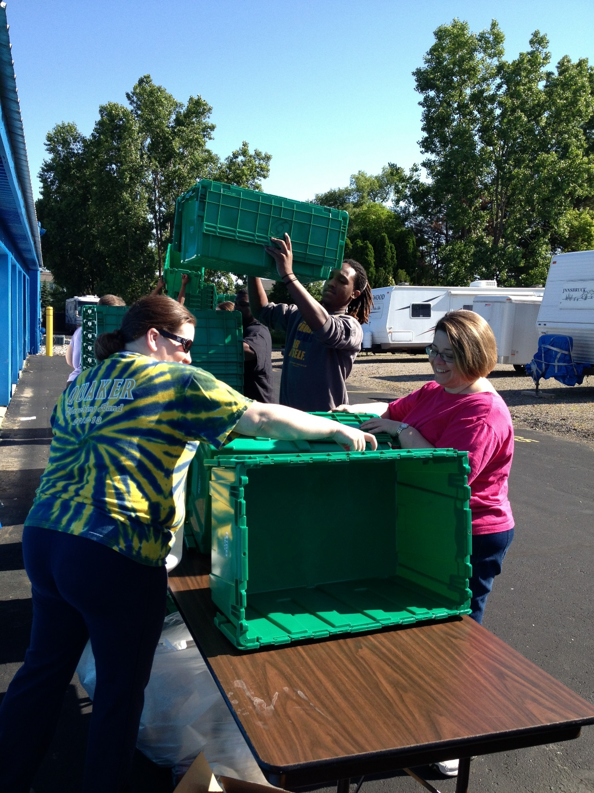
We barcoded and stacked…

Slide 30
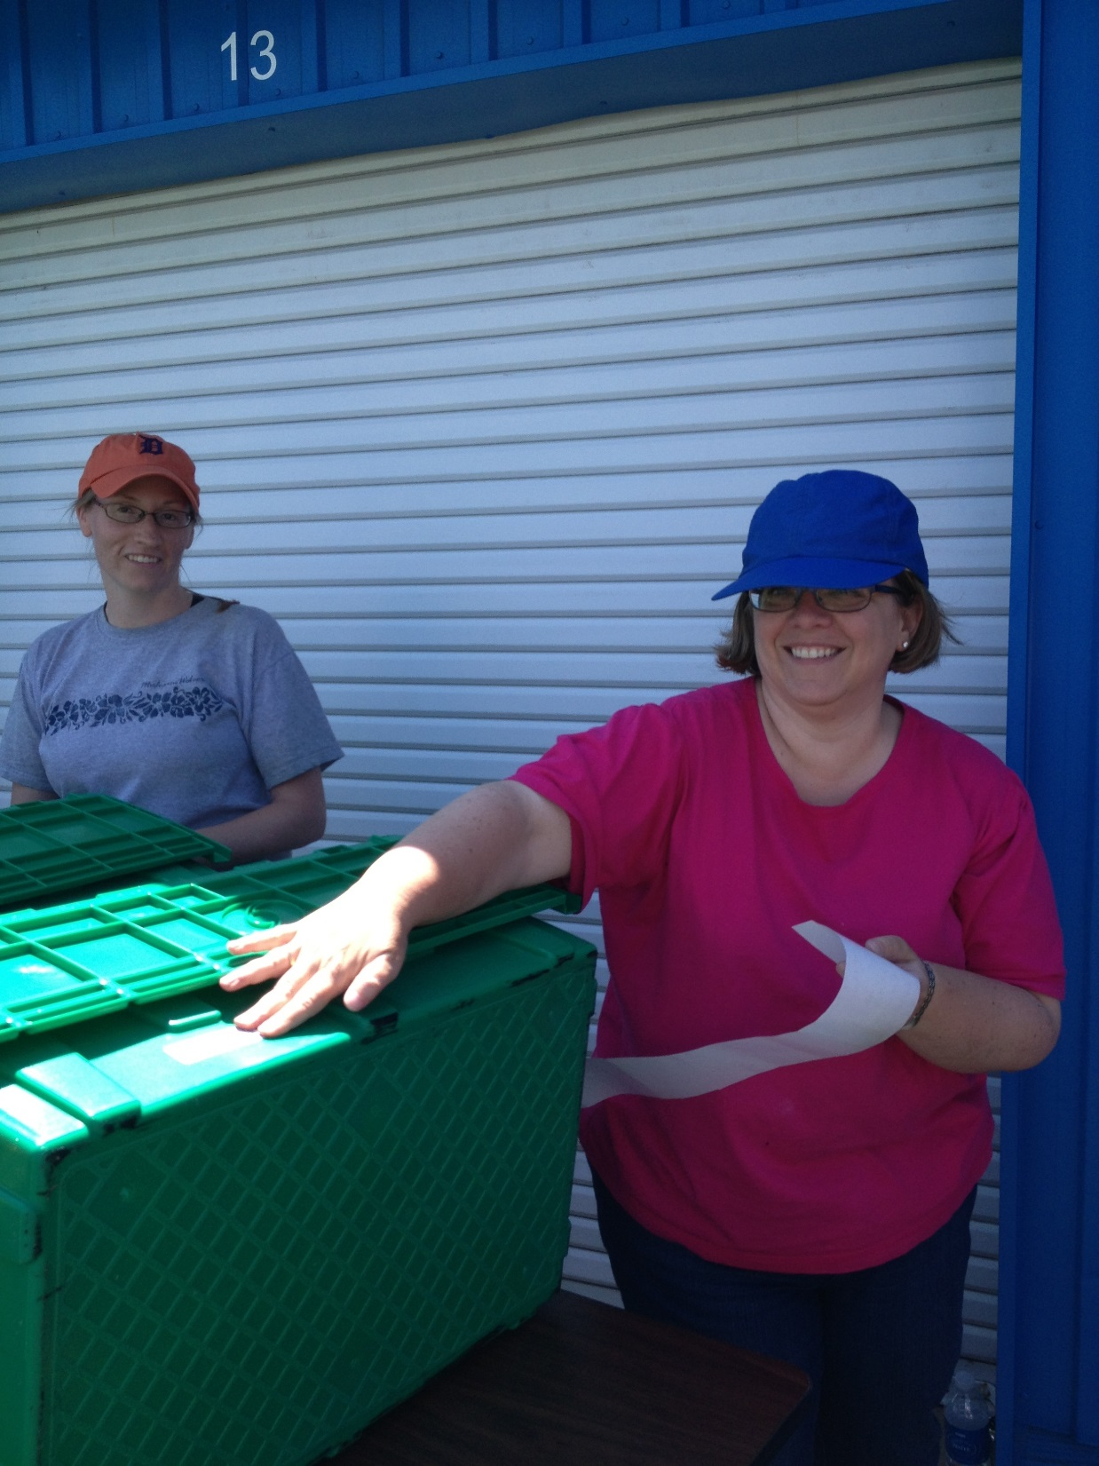
…until the LAST barcode was stuck to the last tote!

Slide 31
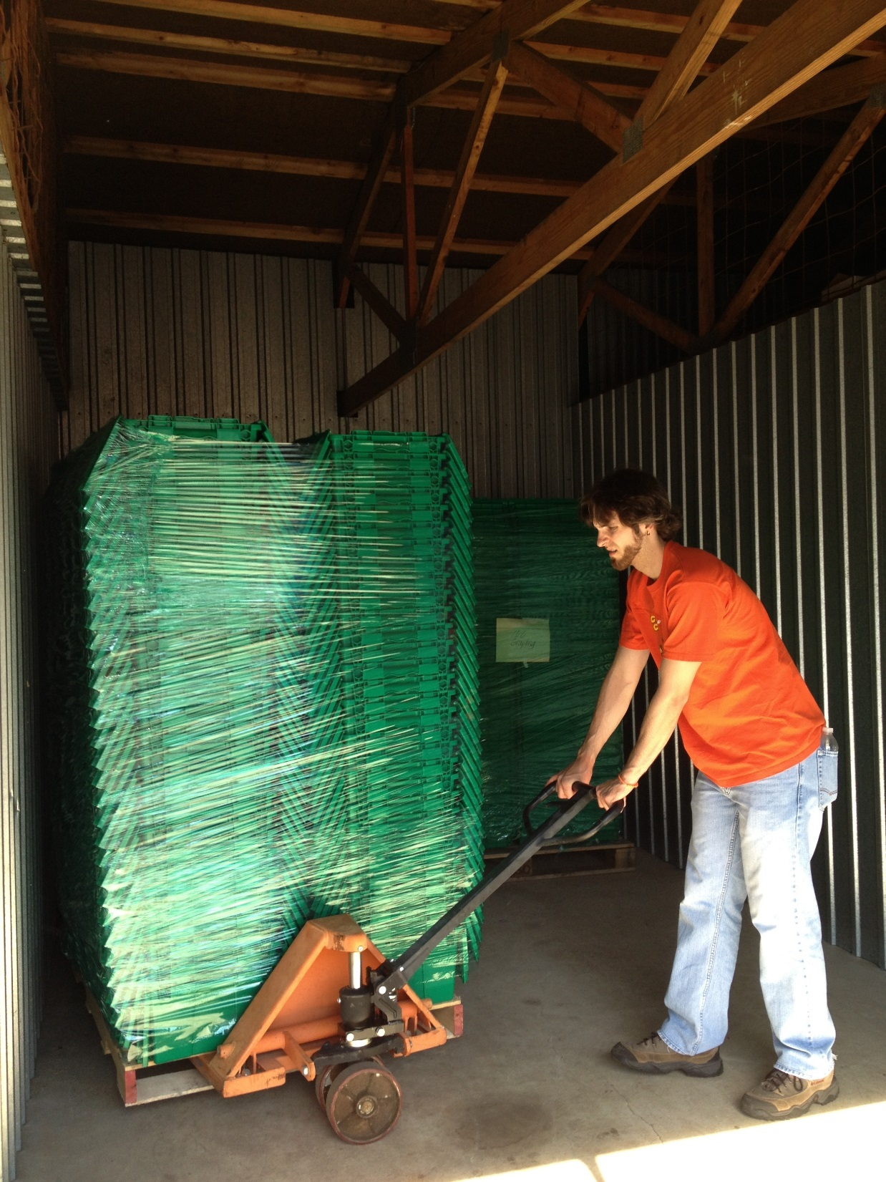
The pallets of newly barcoded totes then awaited pick up back in the storage unit.

Slide 32
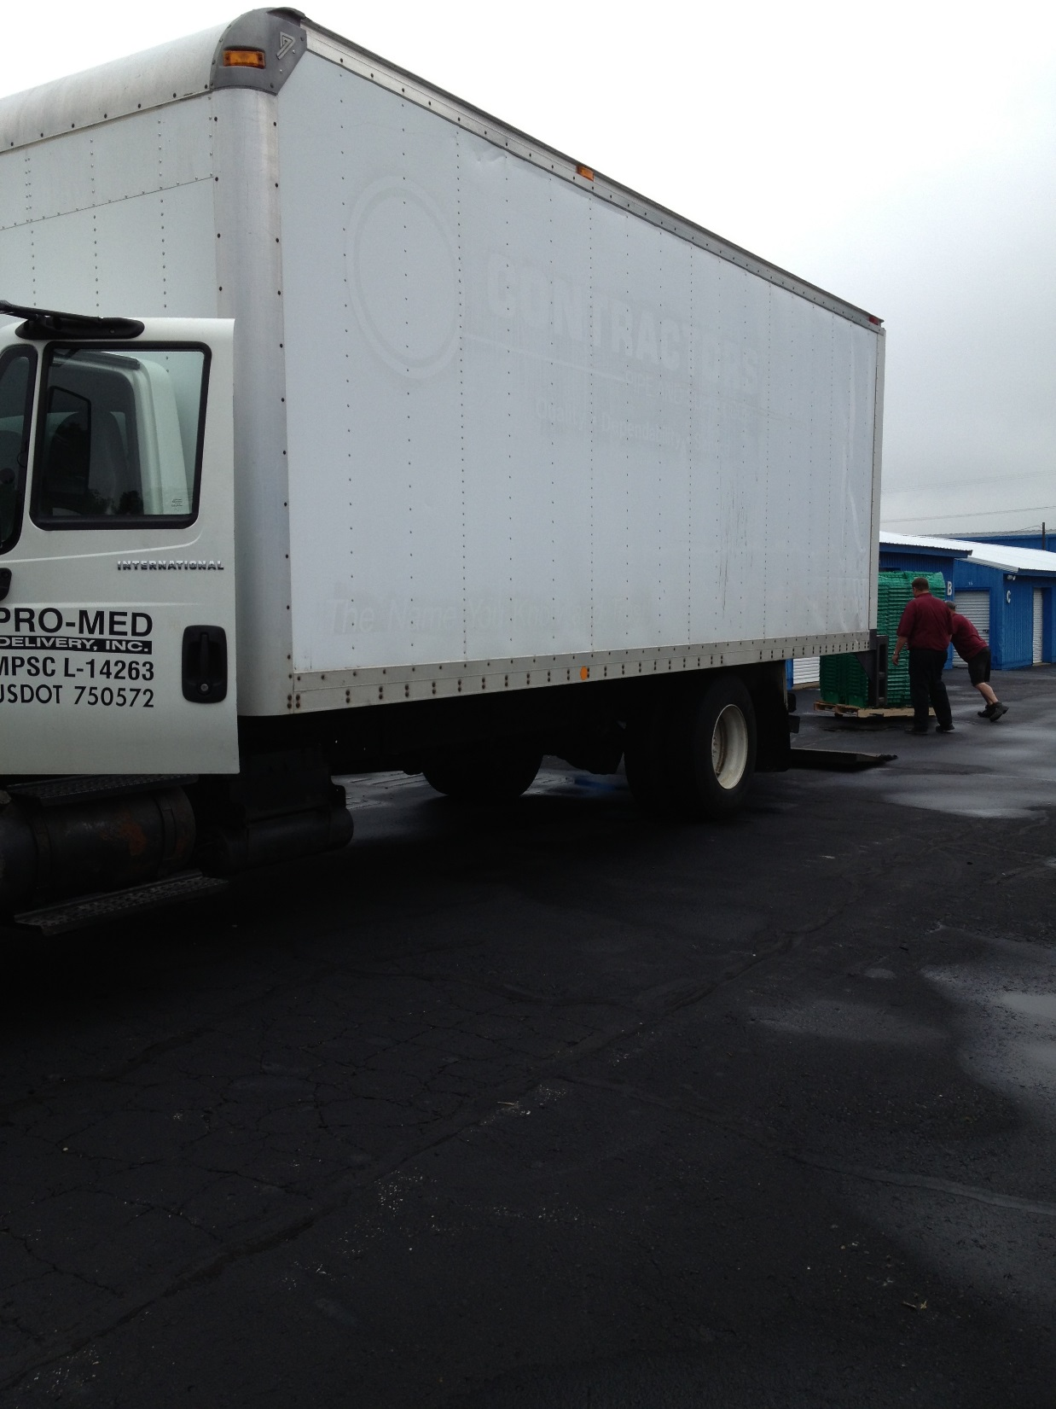
ProMed made several trips to pick up the totes.
(Yes, it was raining.)

Slide 33
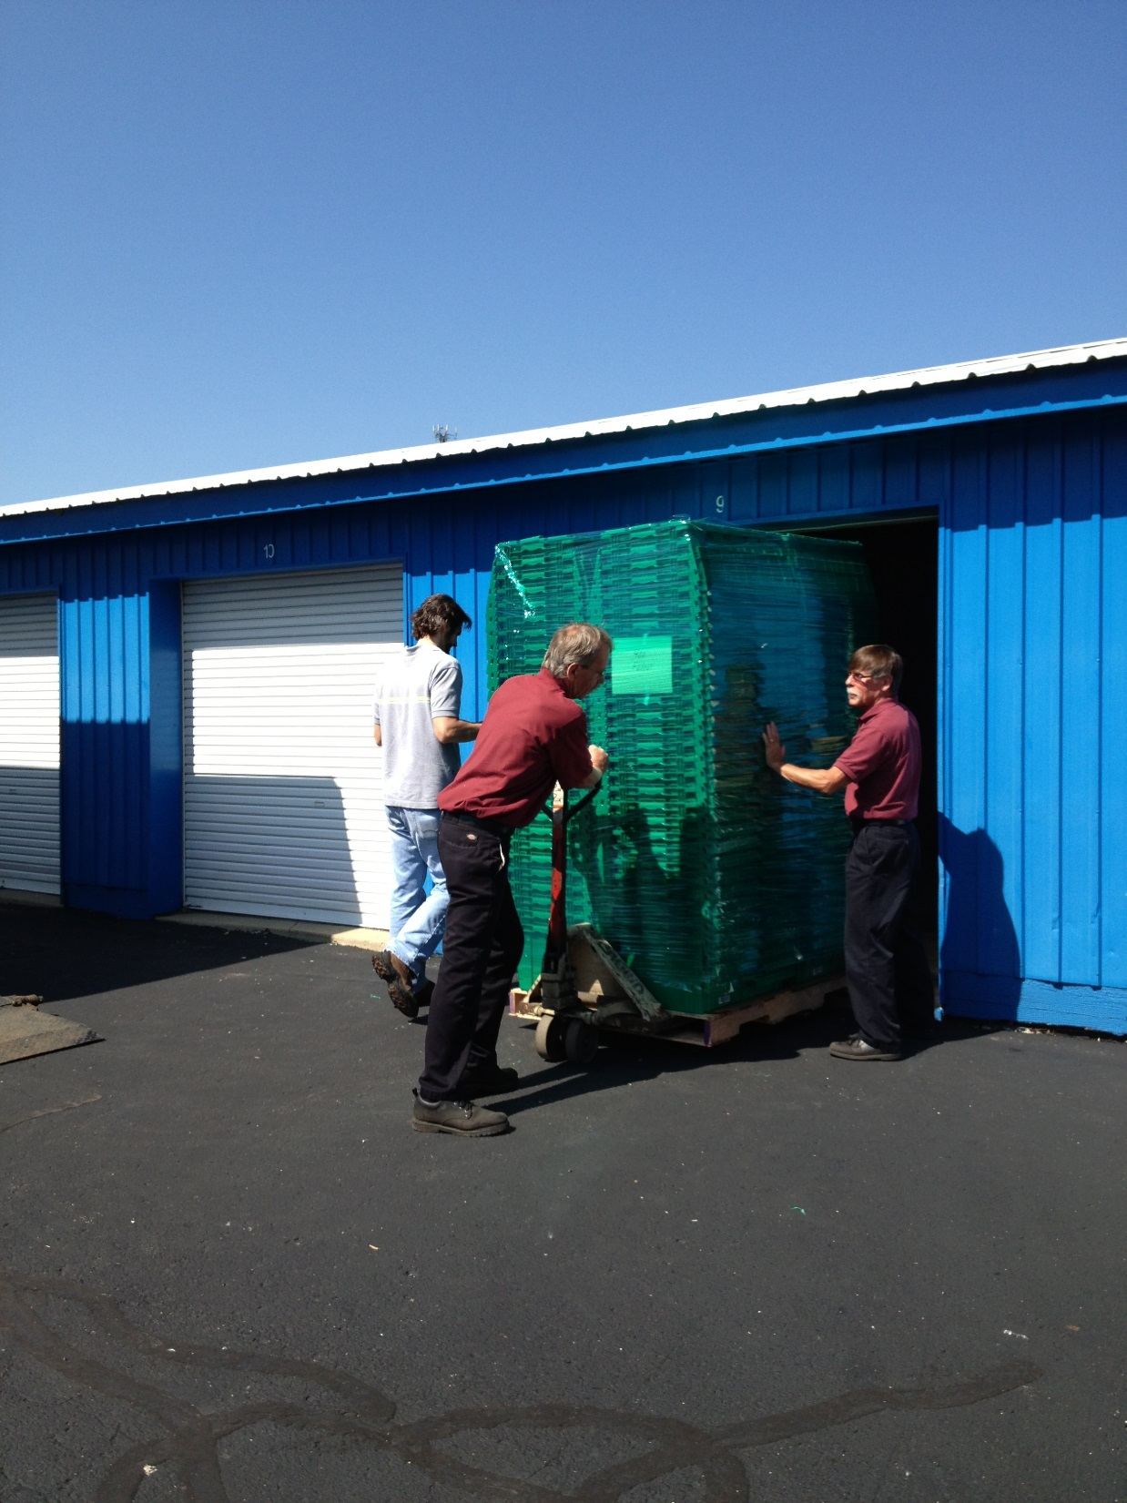
We learned many, many things with this project.
Among them, using a pallet jack.

Slide 34
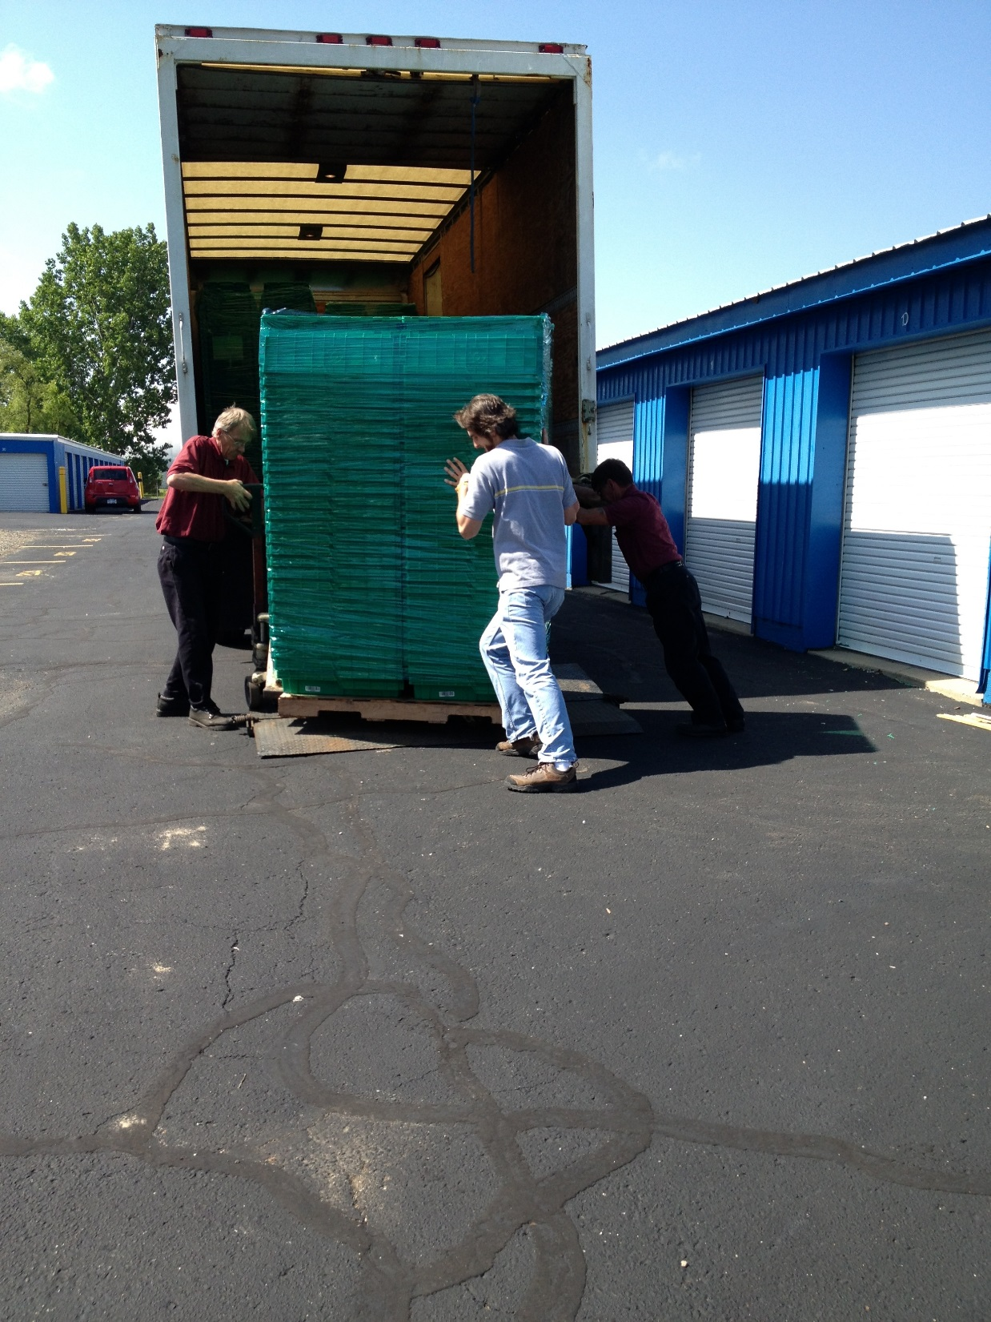
And loading a truck with a lift gate.
But we got all of the totes into the trucks!

Slide 35
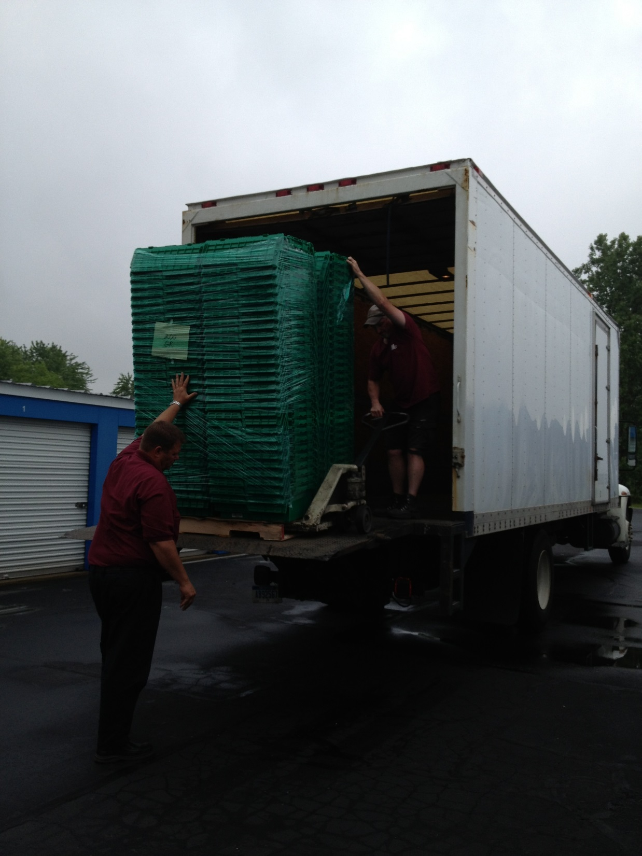
They were taken to the ProMed warehouses to be distributed throughout the state.

Slide 36
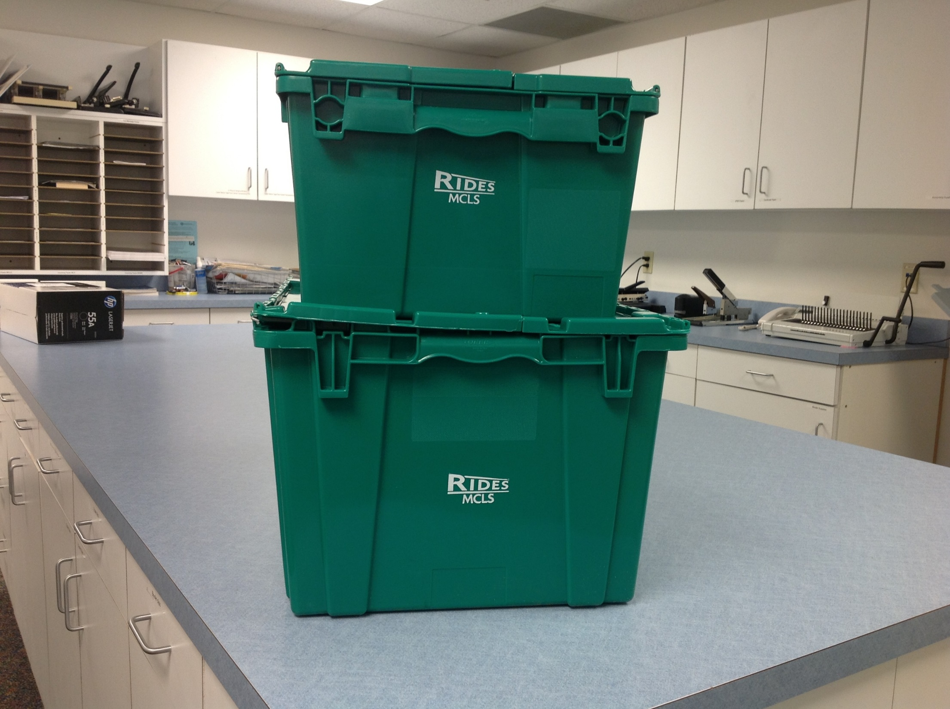
Each tote is stamped with the RIDES logo.

Slide 37
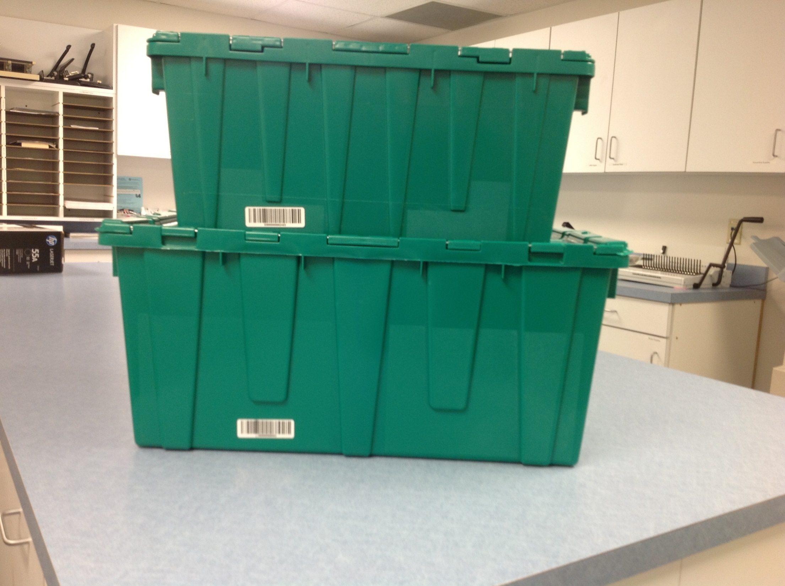
And each tote is barcoded on two sides with matching barcodes.

Slide 38
The End

