Slide 1
Michigan Shared Print Initiative

Slide 2
Shared Print Initiative
Pilot Project
Council of Library Deans/Directors, in conjunction with MCLS and Sustainable Collection Services (SCS), have developed a collaborative approach to maintaining print collections.

Slide 3
Pilot Project Participants
Wayne State
Western Michigan
Central Michigan
Eastern Michigan
GVSU
Michigan Tech
SVSU

Slide 4
Why Do this Project?

Slide 5
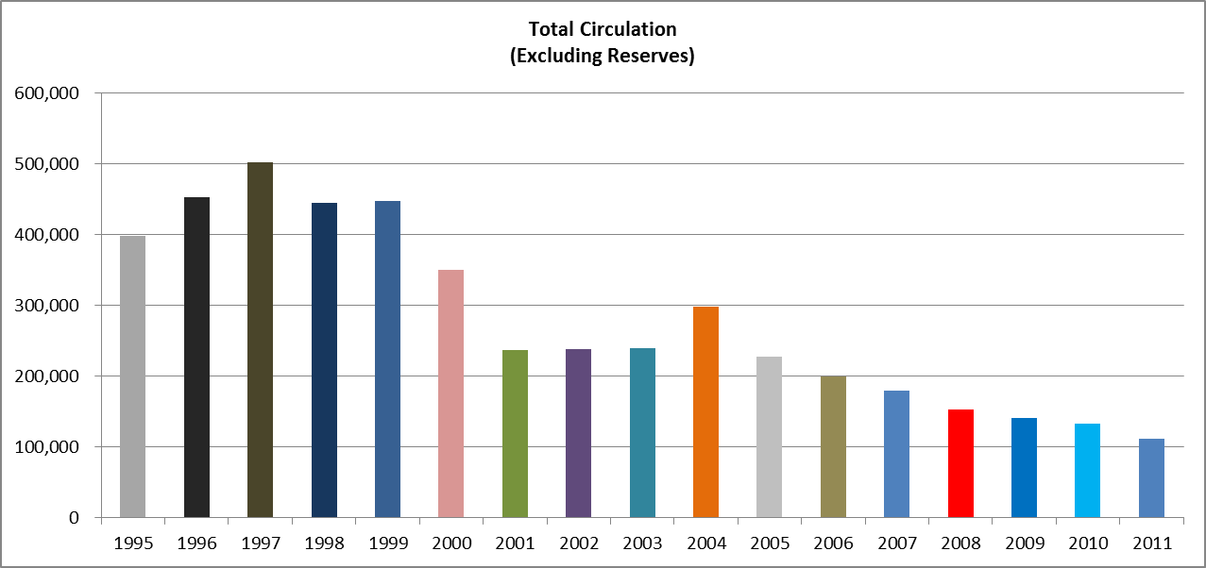
Circulation is Falling
1997 – 502,660
2011 – 111,284

Slide 7
2011 – 111,284
2016 – 20,000(!)
2016

Slide 8
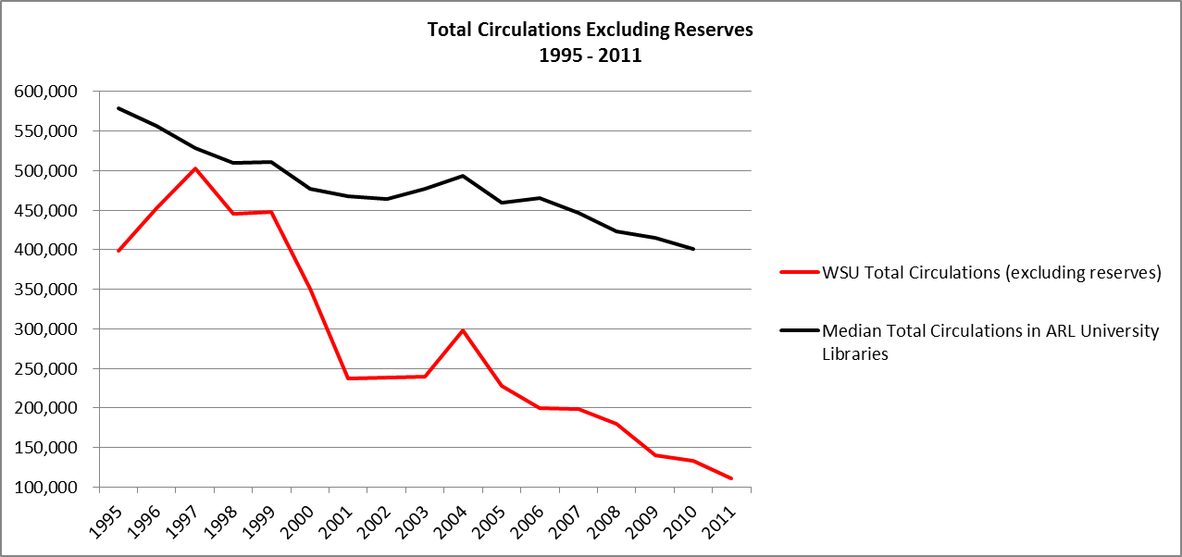

Slide 9
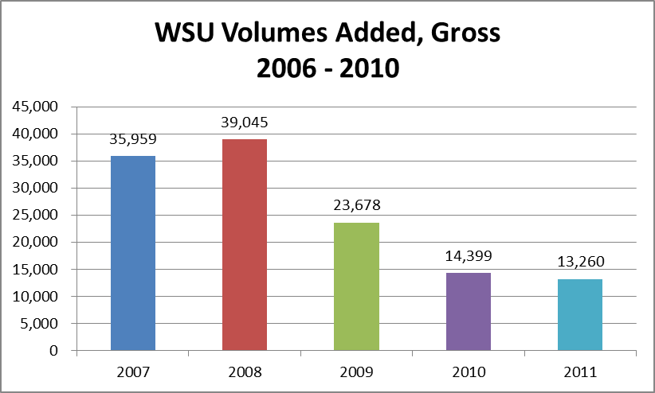

Slide 10
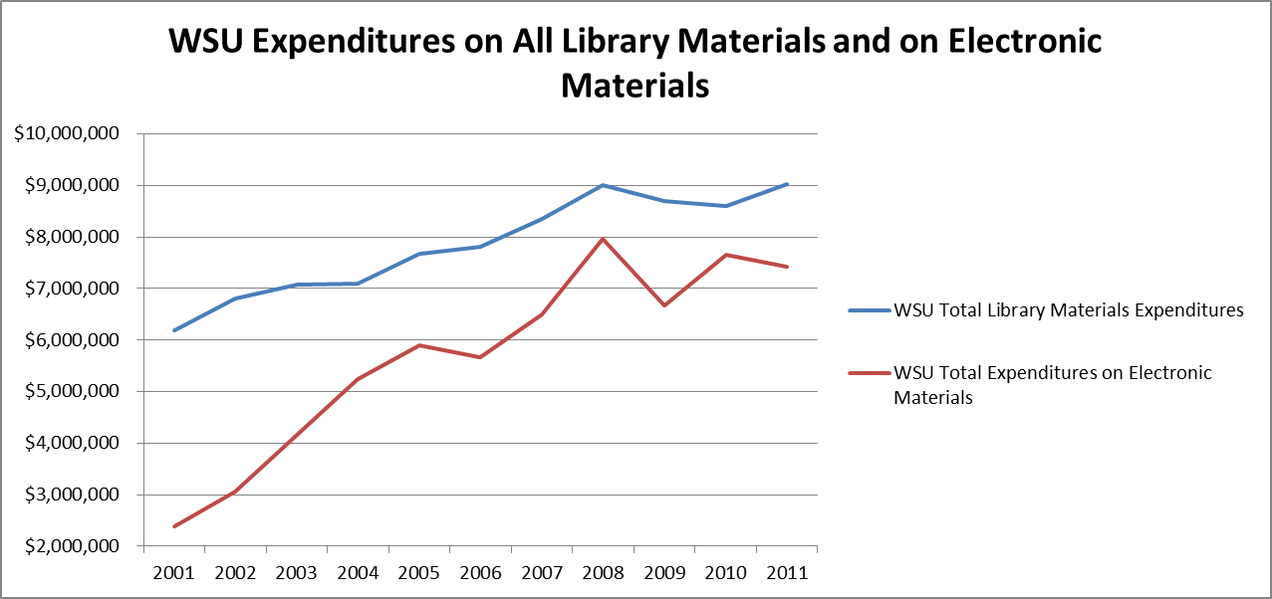

Slide 11
Research Shows:
OHIOLINK Study: 80/6 rule
Cornell University: 55% of books purchased since 1990 never circulated
National studies indicate 13% of volumes stored in open stacks circulate per year
Cost: $4.26 per book per year to keep on the open shelves
Notes:
“On the Cost of Keeping a Book” in The Idea of Order. 2010. by Paul Courant & Matthew “Buzzy” Nielson

Slide 12
Notes:
Allan Kent et al., Use of Library Materials: The University of Pittsburgh Study. New York: Marcel Dekker, 1979.

Slide 13
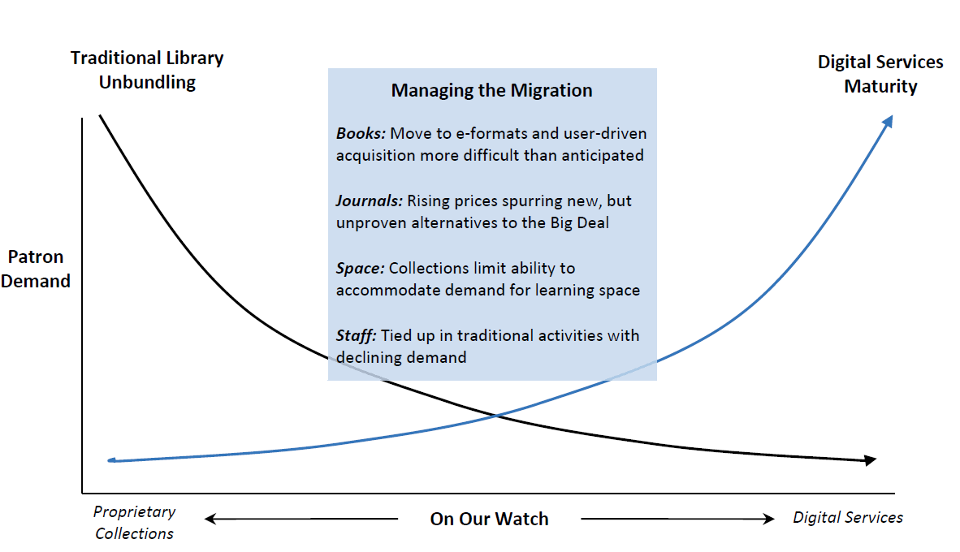

Slide 14
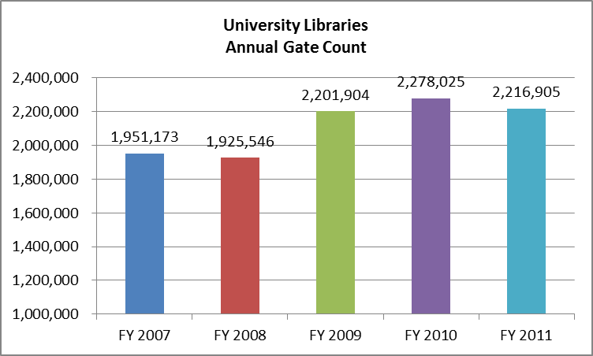
2007 – 1,951,173
2011 – 2,216,905

Slide 15
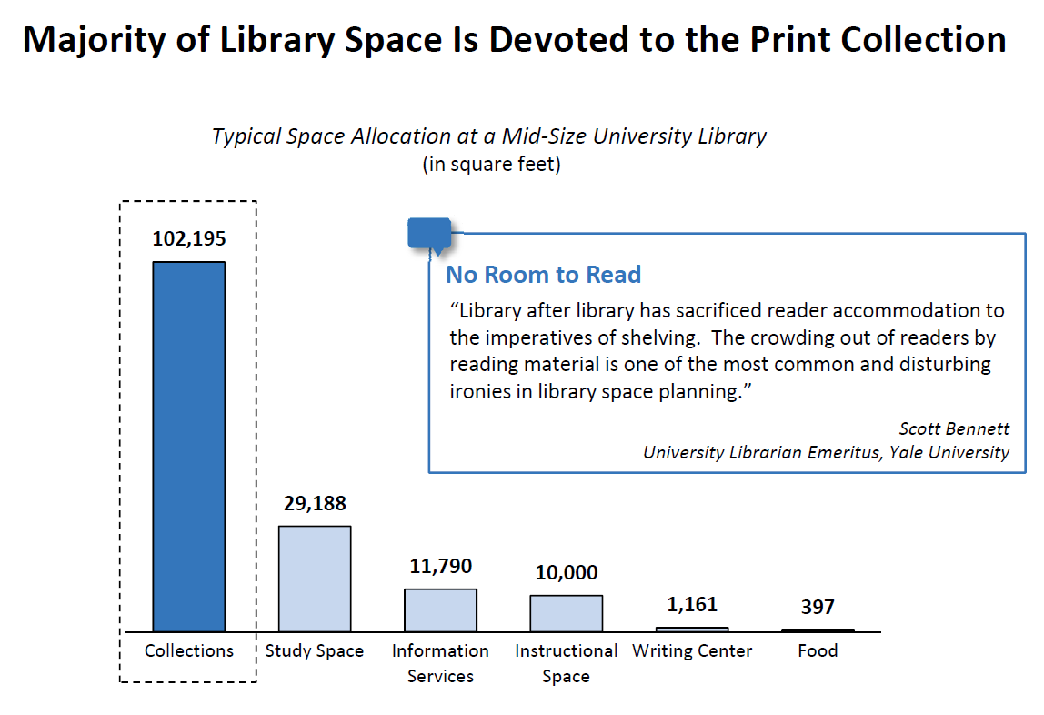

Slide 16
Local print collections cost too much and don’t get used

Slide 17
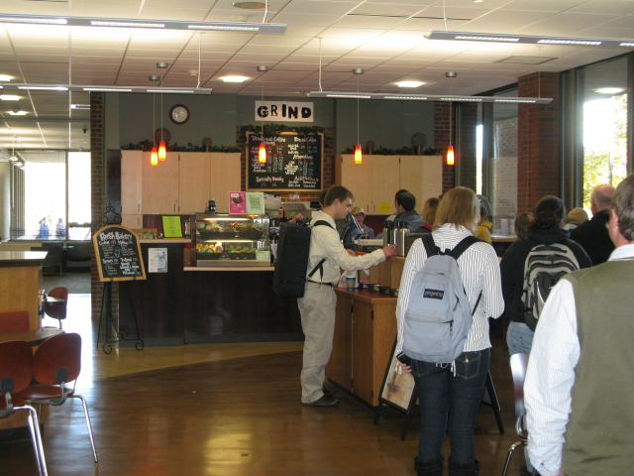
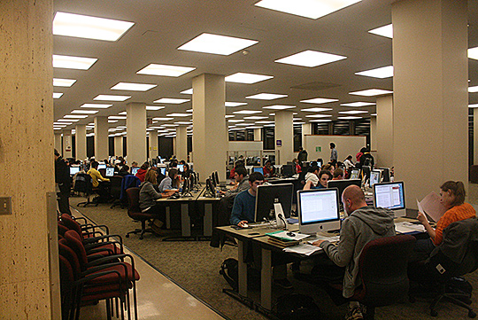
And take up space that could be allocated to other purposes
Photo credit: Study Group at UBC Library by UBC Library Communications. Some rights reserved.
Photo credit: UWM Libraries Coffee Shop by zenhikers. Some rights reserved.

Slide 18
Michigan Response
Michigan libraries have long recognized the advantages of working collaboratively, as COLD, MeLCat, Michicard and other initiatives attest.
It is clear that a shared regional approach to print retention and storage of low-use monographs would be valuable.

Slide 19
The Value of a Shared Collections Strategy
Stacks are overcrowded
Use of print books is low and declining
Library space is wanted for other purposes
Print redundancy is significant
The cost of keeping books on shelves is high
Alternatives exist, but data is scattered
Traditional approaches to deselection are costly and time-consuming

Slide 20
A rules-based approach to deselection
Selection and deselection are essentially the same function, performed at different points in a book’s lifecycle
Same techniques could work
Profiles: consistent and customizable treatment
Of new titles: approval
Of older, low-circulation titles: disapproval

Slide 21
The SCS Approach: Data-Driven Deselection
Circulation & other use data (ILL, in-house)
Holdings in other libraries (peer, regional, national)
Secure digital copy (Hathi)
[Commercial availability]
Authoritative title lists
Library-defined rules
Interactive rule sets

Slide 22
Define the deselection universe
Low-use or no-use titles
Total charges
Length of time titles held
Acquisition date; date item record created
Titles widely held elsewhere
WorldCat; US; State; consortial partners; peers
Titles that will be kept regardless of use
Authoritative title lists

Slide 23
Assemble data on accessibility
Service copy or copies
Regional service center
Availability of alternate editions
Availability of eBook editions or PDA records
Print on Demand
Used book market

Slide 24
Use data to inform deselection decisions
Construct query to test results of rules
Iterate until satisfied
Produce withdrawal candidate lists
Produce preservation candidate lists

Slide 25
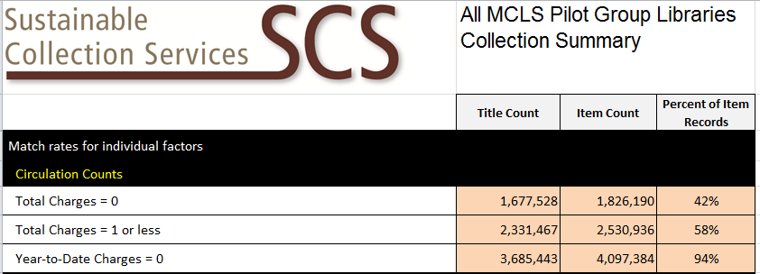

Slide 26
MI - SPI Scope
Monographs only
Multi-volume monographic sets
No serials
No “Special” collections
No Gov Docs, Reference, Reserves, etc..

Slide 27
MI - SPI Basics
SCS to identify monographic titles in respective library collections, and to compare overlap results across the group
Identify titles that are commonly-held with low to no circulation history
Agreed minimum number of copies of each title to be held collectively
Project does not count multiple copies in individual libraries

Slide 28
Three Components
Unique titles held ONLY by one library within group
Commonly held but little used titles
Retention List

Slide 29
Component 1: Unique Titles
Unique locally held titles varies by library
Criteria for identification:
Pre- 2005
Zero circs since 1999
More than 50 US holdings in OCLC or Hathi Trust match
Individual library decides how to handle

Slide 30
Component 2: Titles held among group
Books with:
3 or fewer circulations since 1999
Pub date or add date prior to 2005
Held by more than 2 libraries
Projected withdrawal total is 534,039

Slide 31
Component 3: Retention List
A list for each participating library, generated by SCS’s algorithm, identifying titles to be retained on behalf of the “collective collection”
Retention assignments tied to circulation as much as possible

Slide 32
Allocation of Titles
Library | Retention Count | Withdrawal Count
CMU | 204,686 | 37,438
EMU | 172,423 | 67,221
GVSU | 45,497 | 49,654
MTU | 24,899 | 48,655
SVSU | 30,094 | 53,724
WSU | 86,633 | 165,858
WMU | 172,004 | 111,607

Slide 33
Memorandum of Understanding
15 year commitment to work with group
Open to all COLD libraries
New participants must agree to terms of MOU
Commitment to retention
Lost/damaged
Notification mechanism

Slide 34
Long Term Goals
Reduce the physical collections foot print
Improve study space, promote library as place
Help to identify potential titles for digitization and inclusion into HathiTrust
Continue to build “collective collections” in Michigan and US

Slide 35
Questions

