Slide 1



Michigan Shared Print Initiative

Slide 2

Shared Print Initiative
Council of Library Deans/Directors, in conjunction with MCLS and Sustainable Collection Services (SCS), have developed a collaborative approach to maintaining print collections.

Slide 3
Project Participants
Eastern Michigan
Grand Valley State University
Central Michigan
Michigan Technological University
Saginaw Valley State University
Wayne State University
Western Michigan
Ferris State University
Oakland University

Slide 4
Why Do this Project?

Slide 5
Research Shows:
OHIOLINK Study: 80/6 rule
Cornell University: 55% of books purchased since 1990 never circulated
National studies indicate 13% of volumes stored in open stacks circulate per year
Cost: $4.26 per book per year to keep on the open shelves
Among ARL libraries, circulation is dropping

Slide 6
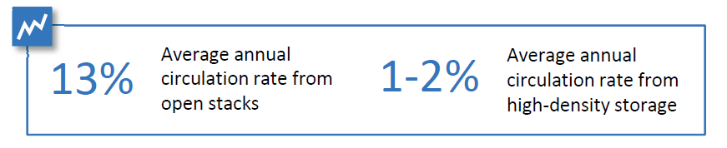


Slide 7
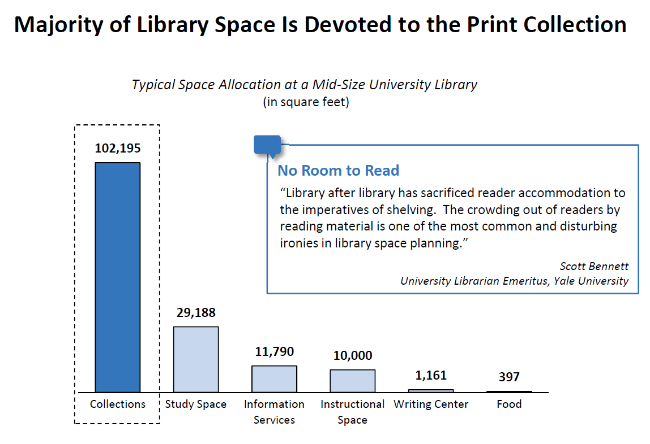

Slide 8
Local print collections take up too much space, cost too much, and don’t get used

Slide 9

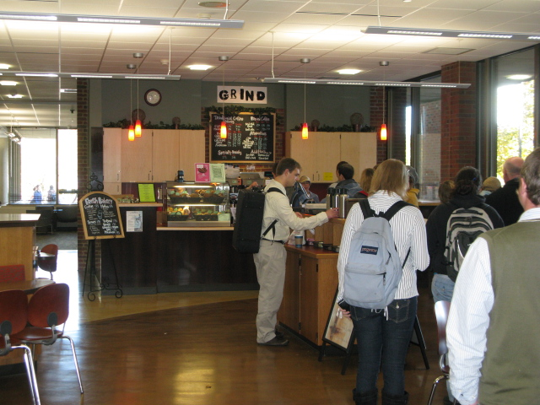
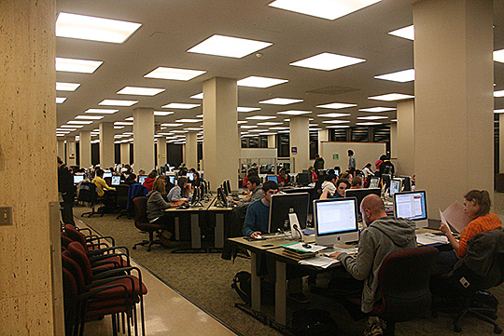
And take up space that could be allocated to other purposes
Photo credit: Study Group at UBC Library by UBC Library Communications. Some rights reserved.
Photo credit: UWM Libraries Coffee Shop by zenhikers. Some rights reserved.

Slide 10
Michigan Response
Michigan libraries have long recognized the advantages of working collaboratively, as COLD, MeLCat, Michicard and other initiatives attest.
It is clear that a shared regional approach to print retention and storage of low-use monographs would be valuable.

Slide 11
The Value of a Shared
Collections Strategy
Stacks are overcrowded
Use of print books is low and declining
Library space is wanted for other purposes
Print redundancy is significant
The cost of keeping books on shelves is high
Alternatives exist, but data is scattered
Traditional approaches to deselection are costly and time-consuming

Slide 12
A Rules-based Approach to Deselection
Selection and deselection are essentially the same function, performed at different points in a book’s lifecycle
Same techniques could work
Profiles: consistent and customizable treatment
    Of new titles: approval
    Of older, low-circulation titles: disapproval

Slide 13
Define the Deselection Universe
Low-use or no-use titles
    Total charges
Length of time titles held
    Acquisition date; date item record created
Titles widely held elsewhere
    WorldCat; US; State; consortial partners; peers
Titles that will be kept regardless of use
Authoritative title lists

Slide 14
MI - SPI Basics
SCS to identify monographic titles in respective library collections, and to compare overlap results across the group
Identify titles that are commonly-held with low to no circulation history
Agreed minimum number of copies of each title to be held collectively
  Project does not count multiple copies in individual libraries

Slide 15
MI - SPI Scope
Monographs only
Multi-volume monographic sets
No serials
No “Special” collections
No Gov Docs, Reference, Reserves, etc..
Timeline

Slide 16
Three Components
Unique titles held ONLY by one library within group
Commonly held but little used titles
Retention List

Slide 17
Component 1: Unique Titles
Unique locally held titles varies by library
  Criteria for identification:
    Pre- 2005
    Zero circs since 1999
    More than 50 US holdings in OCLC or Hathi Trust match
  Individual library decides how to handle

Slide 18
Component 2: Titles held among group
Books with:
  3 or fewer circulations since 1999
  Pub date or add date prior to 2005
  Held by more than 2 libraries
  Projected withdrawal total is 534,039

Slide 19
Component 3: Retention List
A list for each participating library, generated by SCS’s algorithm, identifying titles to be retained on behalf of the “collective collection”
Retention assignments tied to circulation as much as possible

Slide 20
Allocation of Titles
Library | Retention Count | Withdrawal Count
CMU | 204,686 | 37,438
EMU | 172,423 | 67,221
GVSU | 45,497 | 49,654
MTU | 24,899 | 48,655
SVSU | 30,094 | 53,724
WSU | 86,633 | 165,858
WMU | 172,004 | 111,607

Slide 21
Memorandum of Understanding
15 year commitment to work with group
Open to all COLD libraries
  New participants must agree to terms of MOU
Commitment to retention
Lost/damaged
  Notification mechanism

Slide 22
Long Term Goals
Reduce the physical collections foot print
Improve study space, promote library as place
Help to identify potential titles for digitization and inclusion into HathiTrust
Continue to build “collective collections” in Michigan and US

Slide 23

Questions

