Slide 1

Meeting the Public Where They Are:
MeLCat, Linked Data and Web Search
Linked Data Summit 2017
Indianapolis & Lansing
Shannon D. White, Library of Michigan
Debbi F. Schaubman, Midwest Collaborative
for Library Services
http://creativecommons.org/licenses/by-nc-sa/4.0/

Slide 2
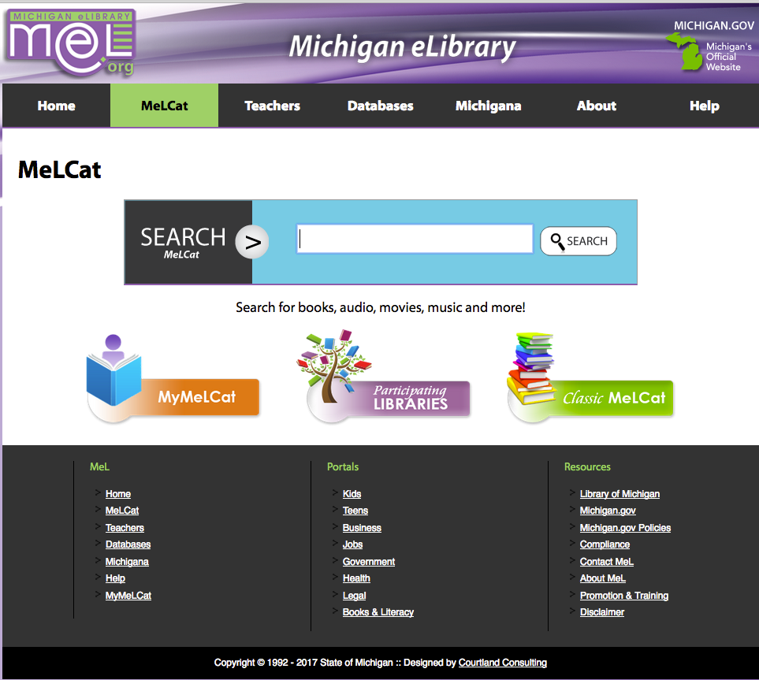

Slide 3
What the Michigan Library Community Wants
To be dynamic and meet the communities' needs in real time
To be innovative, supportive of risk taking, and one which celebrates small successes, works collaboratively, and shares information
To know how to develop relevant programming and projects to meet our communities needs in the 21st century

Slide 4
 | Classic MeLCat |  | MeL Discovery (Encore Duet)
 | Sessions | % of Total | Sessions | % of Total
Direct | 700,414 | 47.31% | 565,514 | 90.97%
Google | 37,416 | 2.53% | 225 | .04%
Bing | 21,526 | 1.45% | 3 | 0%
Yahoo | 12,812 | .87% | 2 | 0%

Slide 5
“The move toward Linked Data will be the most significant change in library data in [the last 2] centuries.”
-- Karen Coyle (2013)

Slide 6


Slide 7
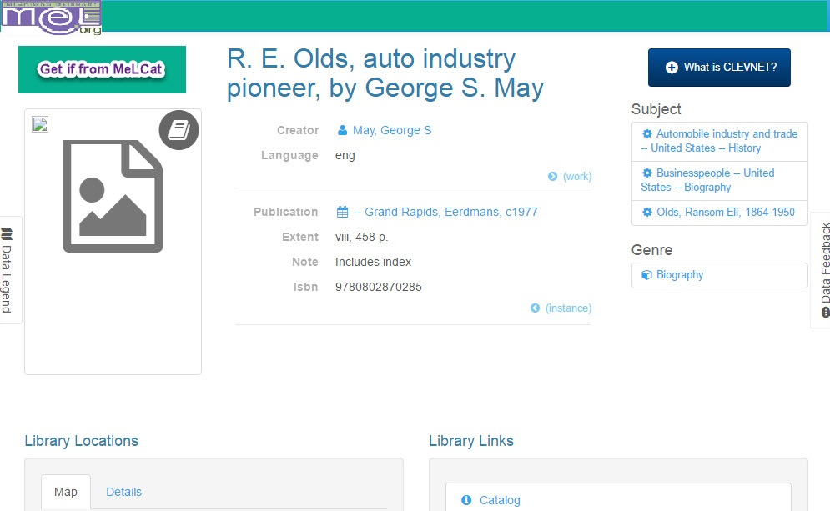


Mock up of possible page

Slide 8

Getting there
Current status
Challenges

Slide 9
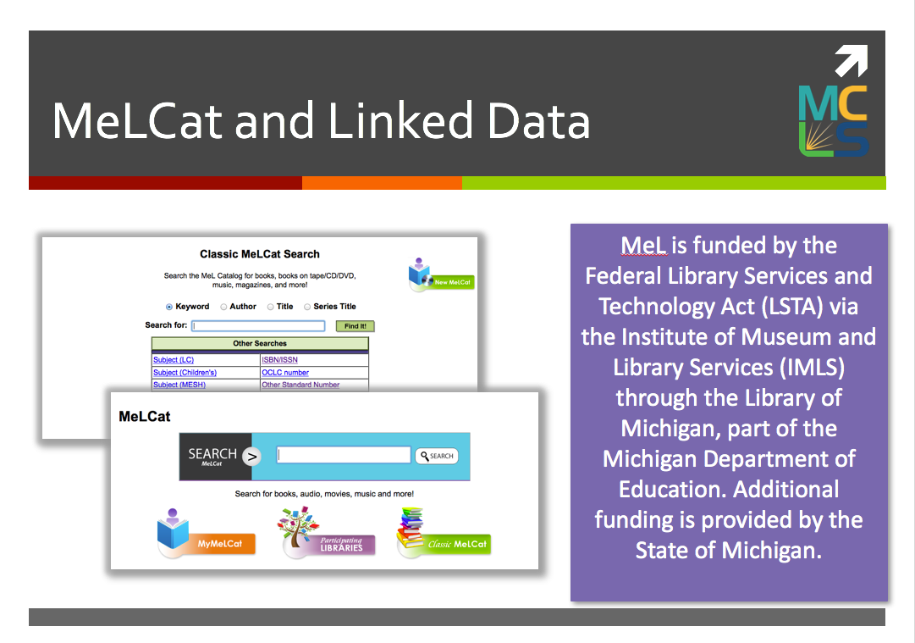

Slide 10


Slide 11


