Slide 1
Material Guidelines
Condition

Slide 2
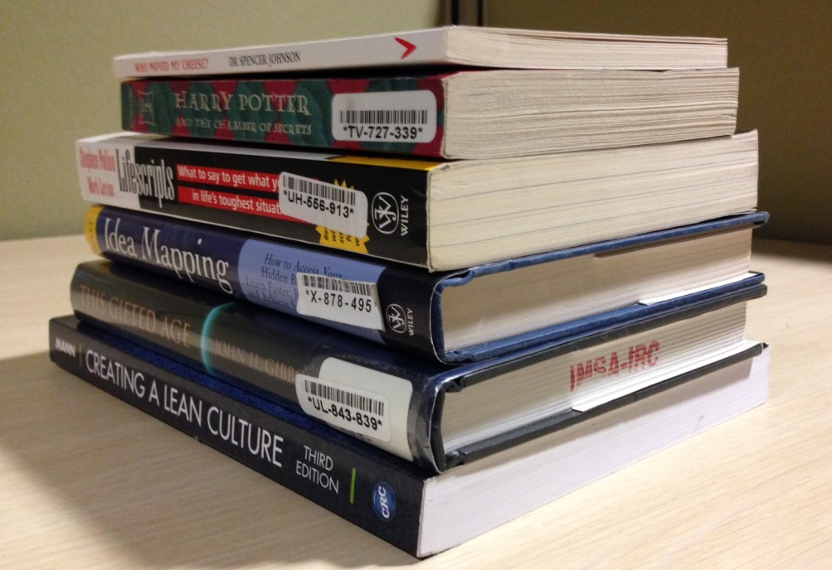
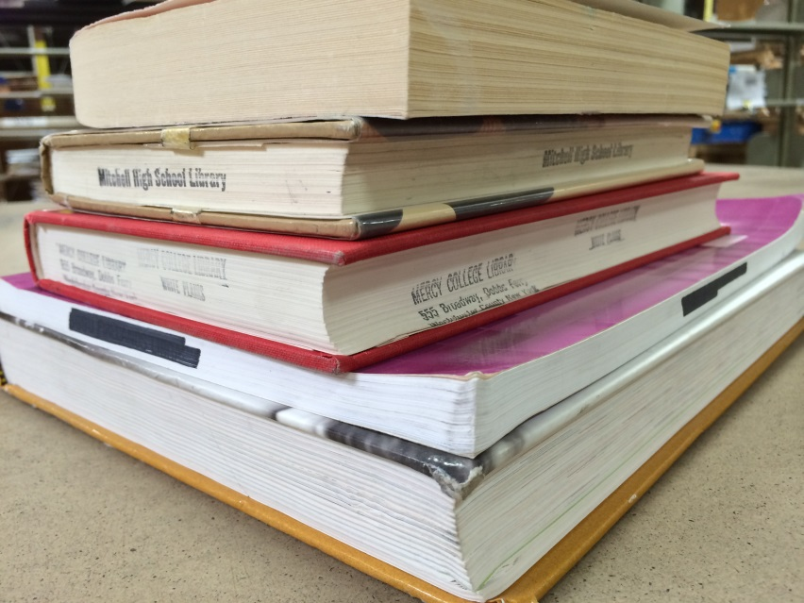
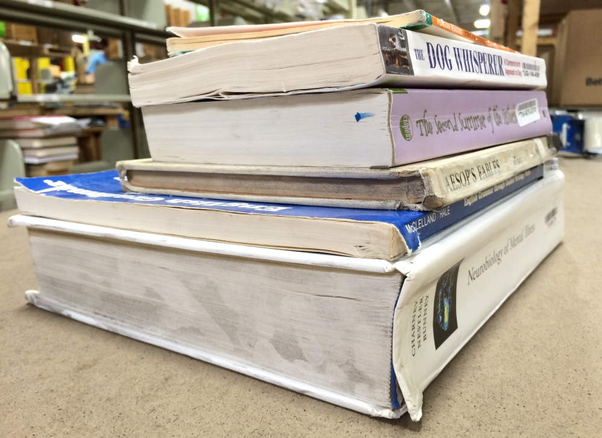
Like New
Very Good
Good
Acceptable
Notes:
Like New: never opened
Very Good: read once – no markings
Good: slight marking
Acceptable: more advanced wear

Slide 3
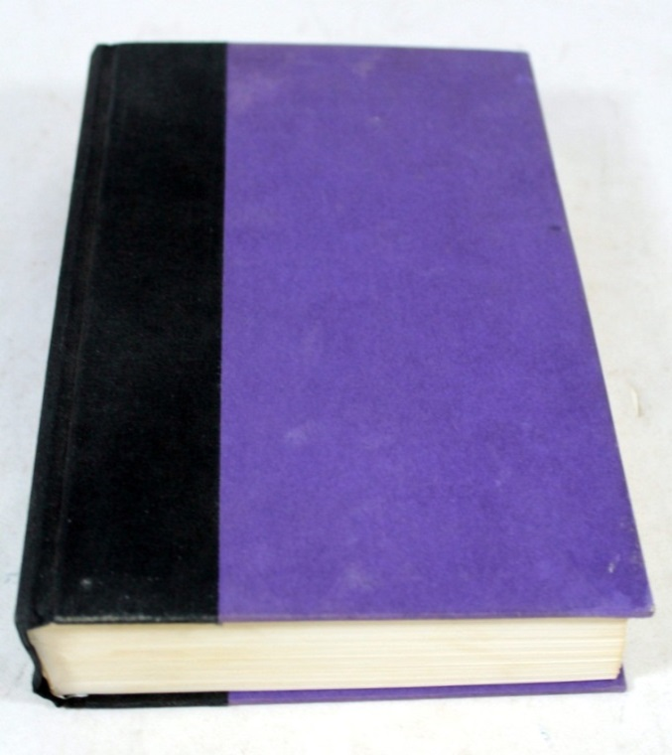
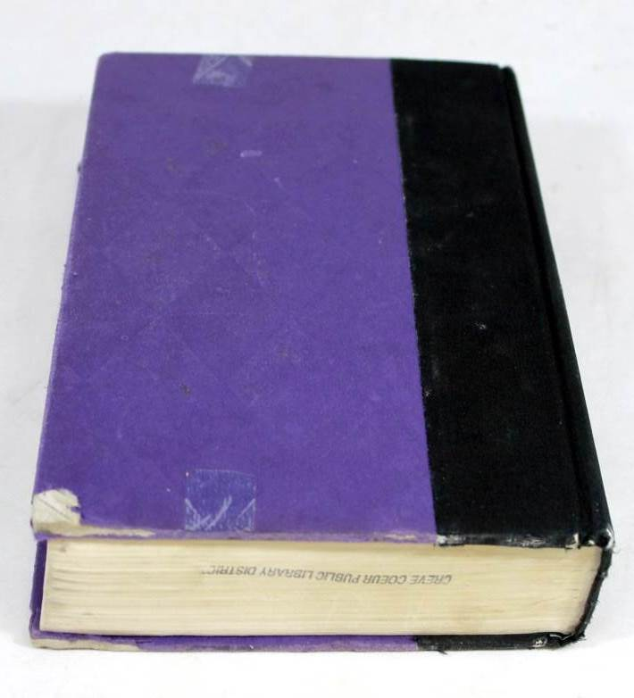
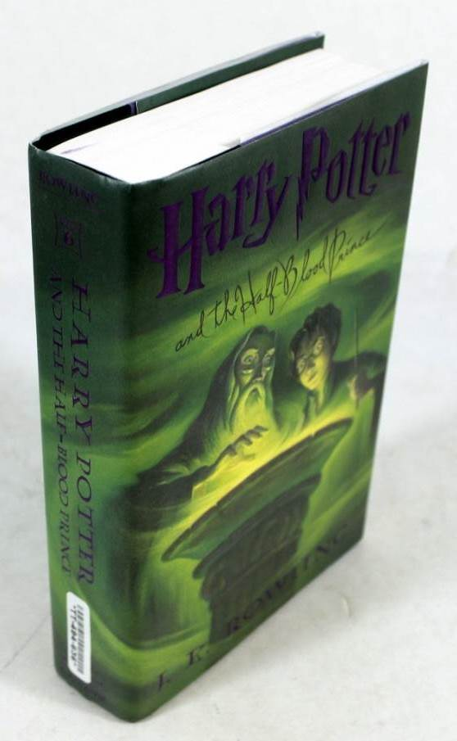
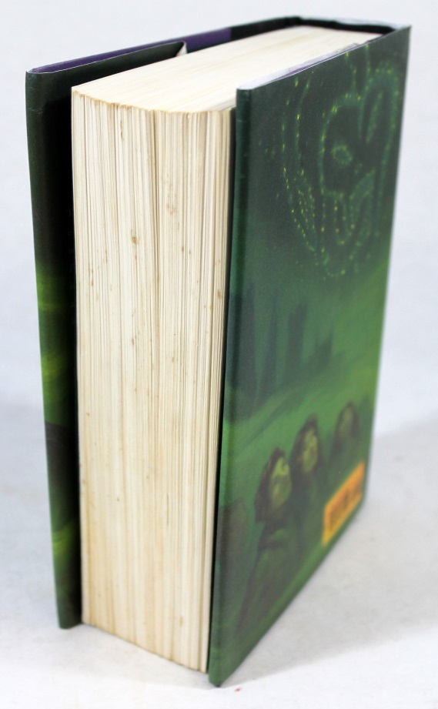
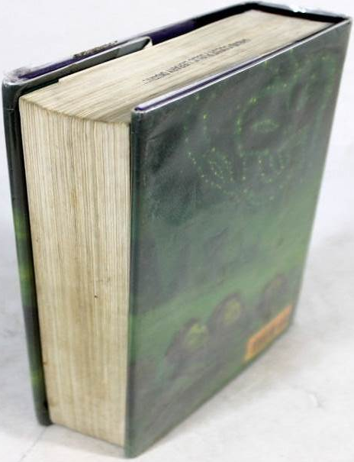
Notes:
Hard cover book
Left to right – examples of Very Good; Good and Acceptable condition.

Slide 4
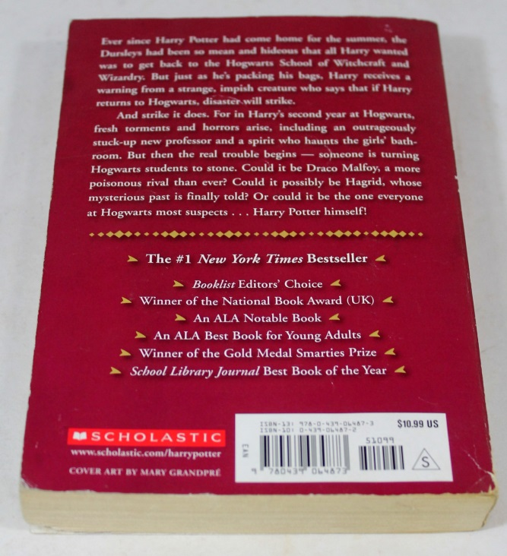
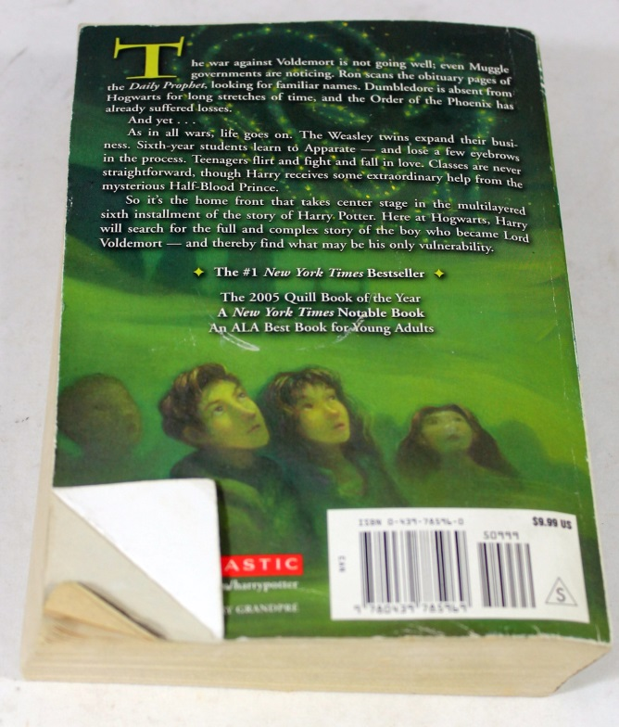
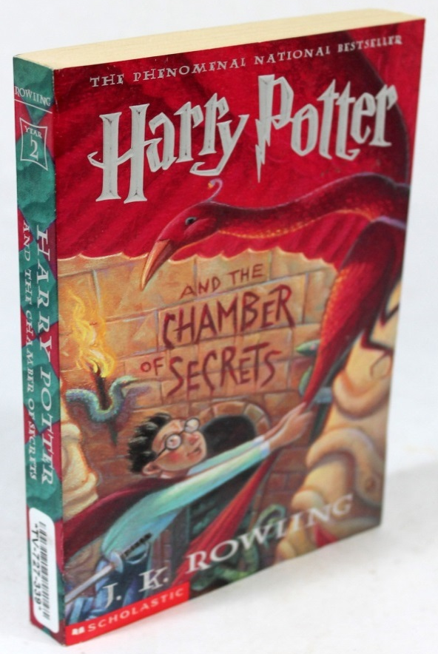
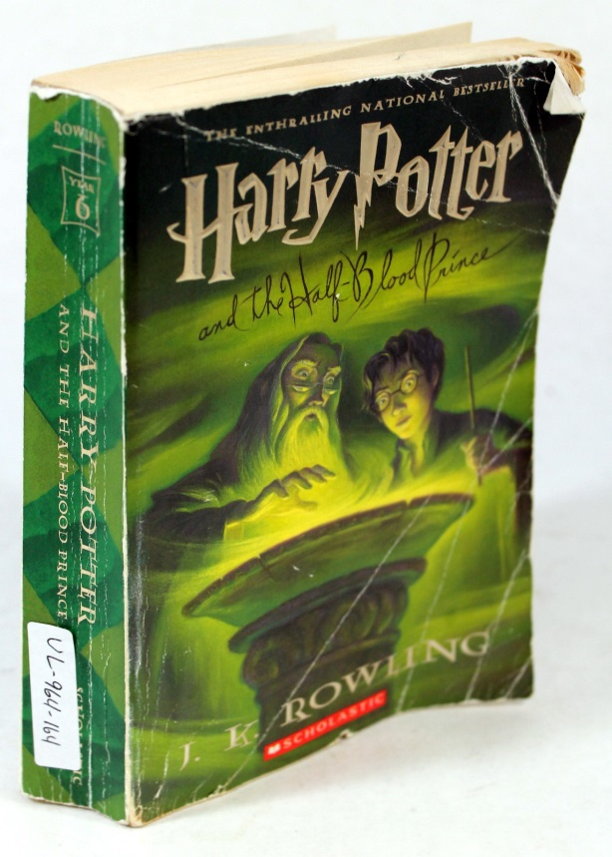
Notes:
Soft cover book
Left to right – examples of Very Good; Good and Acceptable condition.

Slide 5
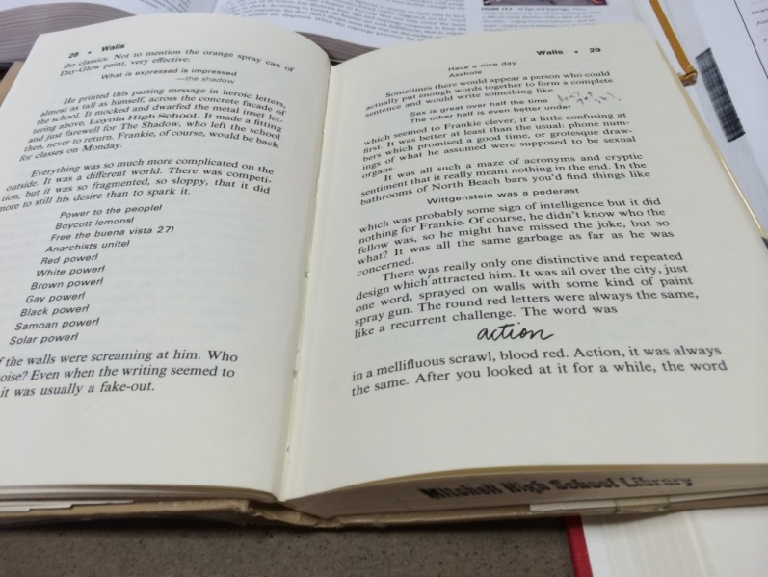
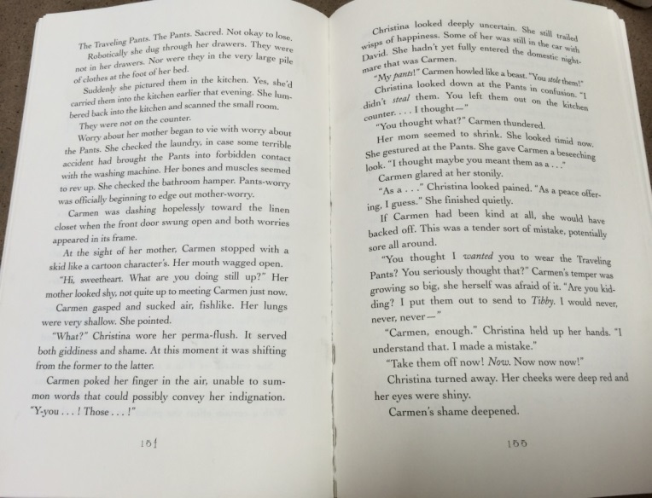
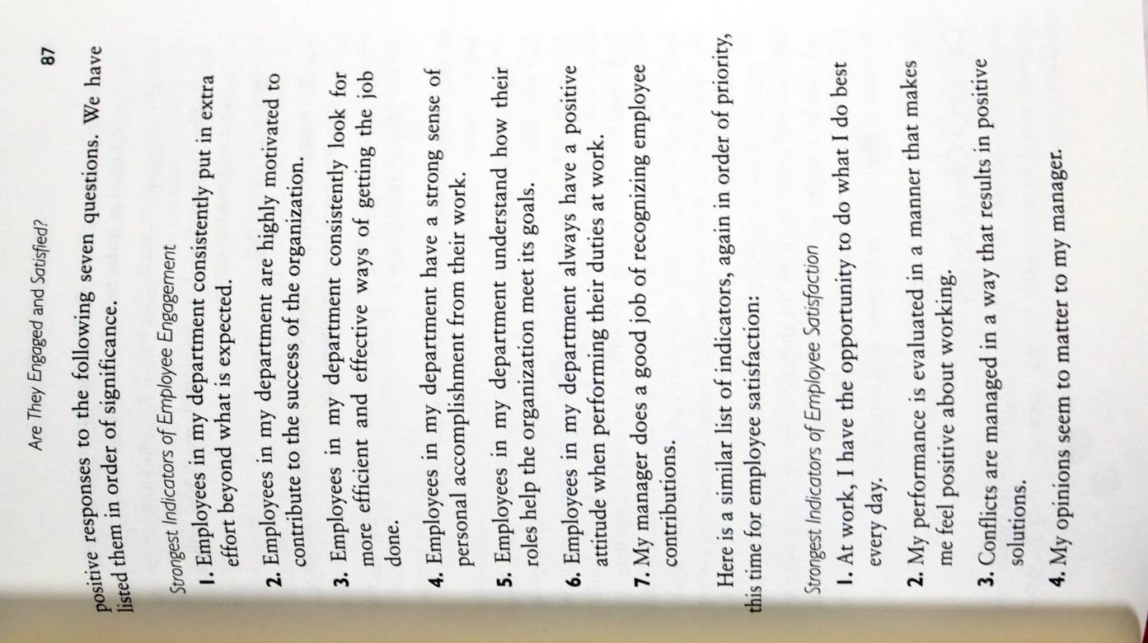
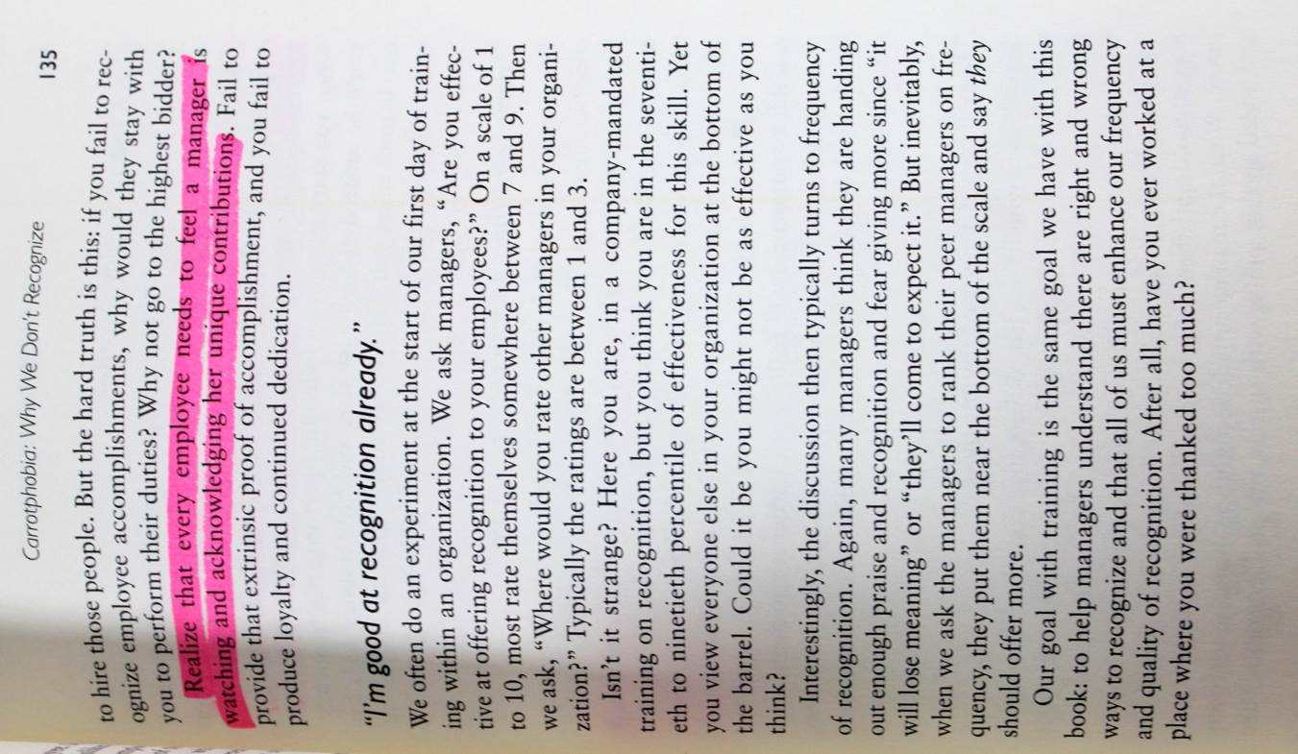
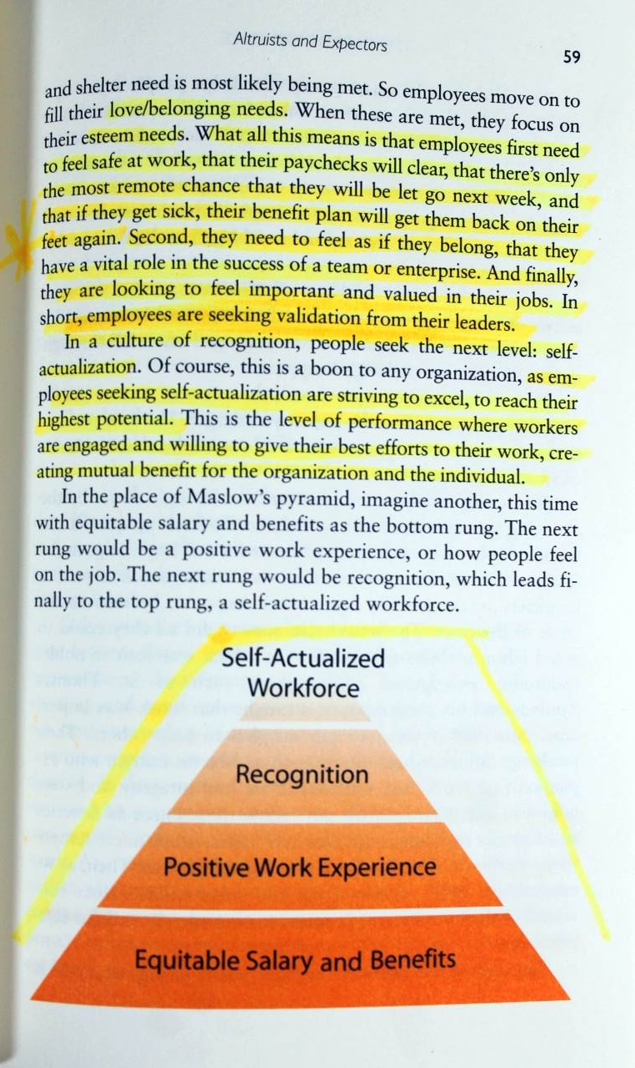
Notes:
Top binding examples
Left to right – Very Good (no breaks in binding); Good (some breaks in binding) and Acceptable (advanced break in binding).
Bottom markings examples
Left to right – Very Good (no markings); Good (minor highlights); Acceptable (heavy highlights) NOTE: but can still read text.

Slide 6
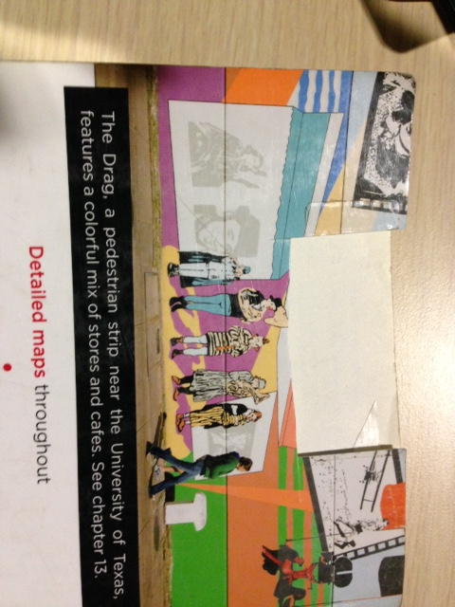
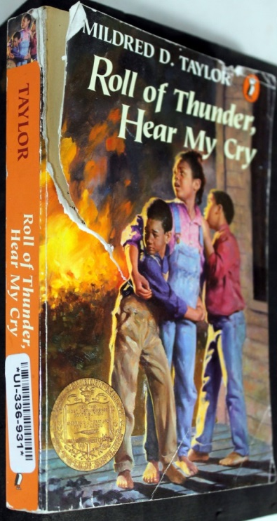
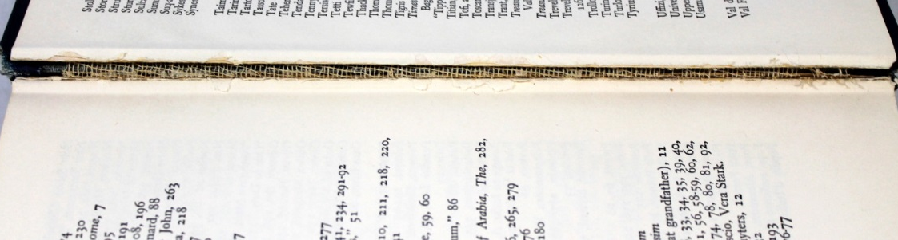
Examples of material which
should be locally recycled
Notes:
Images show water damage; broken binding; torn cover

Slide 7
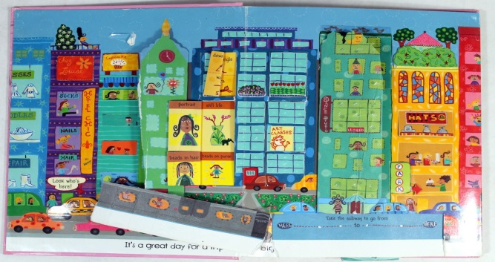
Examples of material which should be locally recycled
Notes:
Images show coloring, written in, missing pages, missing components.

Slide 8
Mold vs Foxing
Notes:
Mold unacceptable.
Foxing acceptable.

Slide 9
